Slide 2
CORE JAVA

Slide 3
CHAPTER 1
Introduction to Java Programming

Slide 4
Objectives
At the end of this session, you will be able to:
State the kind of applications that can be developed using java
Describe the buzzwords of java
Describe the architecture of java
Distinguish between the two types of classloaders

Slide 5
Goals and Features
Aimed at new kind of devices and applications.
  Hand-held devices
  Car computers
  Internet kiosks, etc.
Increasingly used for middleware
Internet based applications
Not to be seen as general purpose programming language.
Notes:
Over the ages people have used tools to help them accomplish tasks, but lately their tools have been getting smarter and interconnected. Microprocessors have appeared inside many commonly used items, and increasingly, they have been connected to networks. As the heart of personal computers and workstations, for example, microprocessors have been routinely connected to networks. They have also appeared inside devices with more specific functionality than the personal computer or the workstation. Televisions, VCRs, audio components, fax machines, scanners, printers, cell phones, personal digital assistants, pagers, and wrist-watches--all have been enhanced with microprocessors; most have been connected to networks. Given the increasing capabilities and decreasing costs of information processing and data networking technologies, the network is rapidly extending its reach.
The emerging infrastructure of smart devices and computers interconnected by networks represents a new environment for software--an environment that presents new challenges and offers new opportunities to software developers. Java is well suited to help software developers meet challenges and seize opportunities presented by the emerging computing environment, because Java was designed for networks. Its suitability for networked environments is inherent in its architecture, which enables secure, robust, platform- independent programs to be delivered across networks and run on a great variety of computers and devices.

Slide 6
Buzzwords of Java
Simple
  Small language [ large libraries ]
  Small interpreter (40 k), but large runtime libraries( 175 k).
Object Oriented
  Supports encapsulation, inheritance, abstraction, and polymorphism.
Distributed
  Libraries for network programming
  Remote Method Invocation
Notes:
Java omits many rarely used, poorly understood, confusing features of C++ that in our experience bring more grief than benefit. These omitted features primarily consist of operator overloading, multiple inheritance, and extensive automatic coercions.
Automatic garbage collection simplifies the task of Java programming but making the system somewhat more complicated. A common source of complexity in many C and C++ applications is storage management: the allocation and freeing of memory. By virtue of having automatic garbage collection the Java language not only makes the programming task easier, it also dramatically cuts down on bugs.
This is, unfortunately, one of the most overused buzzwords in the industry. But object-oriented design is very powerful because it facilitates the clean definition of interfaces and makes it possible to provide reusable "software ICs." Simply stated, object-oriented design is a technique that focuses design on the data (=objects) and on the interfaces to it. The object-oriented facilities of Java are essentially those of C++, with extensions from Objective C for more dynamic method resolution.
Java has an extensive library of routines for coping easily with TCP/IP protocols like HTTP and FTP. This makes creating network connections much easier than in C or C++. Java applications can open and access objects across the net via URLs with the same ease that programmers are used to when accessing a local file system.

Slide 7
Buzzwords of Java
Secure
  Difficult to break Java security mechanisms.
  Java Bytecode verification.
  Signed Applets.
Architecture neutral
  Java Bytecodes are interpreted by the JVM.
Portable
  Primitive data type sizes and their arithmetic behavior are specified by the language.
  Libraries define portable interfaces.
Notes:
Java is intended for use in networked/distributed environments. Toward that end, a lot of emphasis has been placed on security. Java enables the construction of virus-free, tamper-free systems. The authentication techniques are based on public-key encryption.
Java was designed to support applications on networks. In general, networks are composed of a variety of systems with a variety of CPU and operating system architectures. To enable a Java application to execute anywhere on the network, the compiler generates an architecture-neutral object file format--the compiled code is executable on many processors, given the presence of the Java runtime system.
The Java compiler does this by generating bytecode instructions which have nothing to do with a particular computer architecture. Rather, they are designed to be both easy to interpret on any machine and easily translated into native machine code on the fly.
Being architecture neutral is a big chunk of being portable, but there's more to it than that. Unlike C and C++, there are no "implementation dependent" aspects of the specification. The sizes of the primitive data types are specified, as is the behavior of arithmetic on them.
The libraries that are a part of the system define portable interfaces. For example, there is an abstract Window class and implementations of it for Unix, Windows NT/95, and the Macintosh.

Slide 8
Buzzwords of Java
Multithreaded
  Threads are easy to create and use ( perhaps easier than any other programming language).
Dynamic
  Finding Runtime Type Information is easy.
Notes:
There are many things going on at the same time in the world around us. Multithreading is a way of building applications with multiple threads. Unfortunately, writing programs that deal with many things happening at once can be much more difficult than writing in the conventional single-threaded C and C++ style.
Java has a sophisticated set of synchronization primitives that are based on the widely used monitor and condition variable paradigm introduced by C.A.R.Hoare. By integrating these concepts into the language (rather than only in classes) they become much easier to use and are more robust. Much of the style of this integration came from Xerox's Cedar/Mesa system.
Other benefits of multithreading are better interactive responsiveness and real-time behavior. This is limited, however, by the underlying platform: stand-alone Java runtime environments have good real-time behavior. Running on top of other systems like Unix, Windows, the Macintosh, or Windows NT limits the real-time responsiveness to that of the underlying system.
In a number of ways, Java is a more dynamic language than C or C++. It was designed to adapt to an evolving environment.

Slide 9
Notes:
For example, if A distributes an upgrade to its libraries, then all of the software from B will break. It is possible to avoid this problem in C++, but it is extraordinarily difficult and it effectively means not using any of the language's OO features directly. By making these interconnections between modules later, Java completely avoids these problems and makes the use of the object-oriented paradigm much more straightforward. Libraries can freely add new methods and instance variables without any effect on their clients.
Classes have a runtime representation: there is a class named Class, instances of which contain runtime class definitions. If, in a C or C++ program, you have a pointer to an object but you don't know what type of object it is, there is no way to find out. However, in Java, finding out based on the runtime type information is straightforward. Because casts are checked at both compile-time and runtime, you can trust a cast in Java. On the other hand, in C and C++, the compiler just trusts that you're doing the right thing.
It is also possible to look up the definition of a class given a string containing its name. This means that you can compute a data type name and have it easily dynamically-linked into the running system.

Slide 10
The Architecture
Java's architecture arises out of four distinct but interrelated technologies:
  the Java programming language
  the Java class file format
  the Java Application Programming Interface
  the Java virtual machine
Notes:
When you write and run a Java program, you are tapping the power of these four technologies. You express the program in source files written in the Java programming language, compile the source to Java class files, and run the class files on a Java virtual machine. When you write your program, you access system resources (such as I/O, for example) by calling methods in the classes that implement the Java Application Programming Interface, or Java API. As your program runs, it fulfills your program's Java API calls by invoking methods in class files that implement the Java API.

Slide 11
The Architecture
Compile time environment Run time Environment
A.java
B.java
C.java
A.class
B.class
C.class
Java compiler
JVM
Object.class
String.class
A.class
B.class
C.class
Notes:
Together, the Java virtual machine and Java API form a "platform" for which all Java programs are compiled. In addition to being called the Java runtime system, the combination of the Java virtual machine and Java API is called the Java Platform (or, starting with version 1.2, the Java 2 Platform). Java programs can run on many different kinds of computers because the Java Platform can itself be implemented in software.

Slide 12
The Java Virtual Machine
A Java virtual machine's main job is to load class files and execute the byte codes they contain.
Only those class files from the Java API that are actually needed by a running program are loaded into the virtual machine.
The byte codes are executed in an execution engine, which is one part of the VM.
Notes:
At the heart of Java's network-orientation is the Java virtual machine, which supports all three prongs of Java's network-oriented architecture: platform independence, security, and network-mobility.
The Java virtual machine is an abstract computer. Its specification defines certain features every Java virtual machine must have, but leaves many choices to the designers of each implementation. For example, although all Java virtual machines must be able to execute Java bytecodes, they may use any technique to execute them. Also, the specification is flexible enough to allow a Java virtual machine to be implemented either completely in software or to varying degrees in hardware. The flexible nature of the Java virtual machine's specification enables it to be implemented on a wide variety of computers and devices.
A Java virtual machine's main job is to load class files and execute the bytecodes they contain. As you can see in the Figure at the next slide, the Java virtual machine contains a class loader, which loads class files from both the program and the Java API. Only those class files from the Java API that are actually needed by a running program are loaded into the virtual machine. The bytecodes are executed in an execution engine.

Slide 13
The Java Virtual machine
Class loader
The Java API
class files
Your program
class files
Byte codes
Execution engine
Fig 1.3: Basic block diagram of the Java virtual machine
Notes:
The execution engine is one part of the virtual machine that can vary in different implementations. On a Java virtual machine implemented in software, the simplest kind of execution engine just interprets the bytecodes one at a time. Another kind of execution engine, one that is faster but requires more memory, is a just-in-time compiler. In this scheme, the bytecodes of a method are compiled to native machine code the first time the method is invoked. The native machine code for the method is then cached, so it can be re-used the next time that same method is invoked. A third type of execution engine is an adaptive optimizer. In this approach, the virtual machine starts by interpreting bytecodes, but monitors the activity of the running program and identifies the most heavily used areas of code. As the program runs, the virtual machine compiles to native and optimizes just these heavily used areas. The rest of the of code, which is not heavily used, remain as bytecodes which the virtual machine continues to interpret. This adaptive optimization approach enables a Java virtual machine to spend typically 80 to 90% of its time executing highly optimized native code, while requiring it to compile and optimize only the 10 to 20% of the code that really matters to performance. Lastly, on a Java virtual machine built on top of a chip that executes Java bytecodes natively, the execution engine is actually embedded in the chip.

Slide 14
The Java Virtual machine
Class loader
Your program
class files
The Java API
class files
Byte codes
Execution engine
Native method invocations
Host operating system
Fig 1.4 : A Java virtual machine implemented in software on top of a host operating system
Notes:
Sometimes the Java virtual machine is called the Java interpreter; however, given the various ways in which bytecodes can be executed, this term can be misleading. While "Java interpreter" is a reasonable name for a Java virtual machine that interprets bytecodes, virtual machines also use other techniques (such as just-in-time compiling) to execute bytecodes. Therefore, although all Java interpreters are Java virtual machines, not all Java virtual machines are Java interpreters.
When running on a Java virtual machine that is implemented in software on top of a host operating system, a Java program interacts with the host by invoking native methods. In Java, there are two kinds of methods: Java and native. A Java method is written in the Java language, compiled to bytecodes, and stored in class files. A native method is written in some other language, such as C, C++, or assembly, and compiled to the native machine code of a particular processor. Native methods are stored in a dynamically linked library whose exact form is platform specific. While Java methods are platform independent, native methods are not. When a running Java program calls a native method, the virtual machine loads the dynamic library that contains the native method and invokes it. As you can see in Figure , native methods are the connection between a Java program and an underlying host operating system.

Slide 15
Notes:
You can use native methods to give your Java programs direct access to the resources of the underlying operating system. Their use, however, will render your program platform specific, because the dynamic libraries containing the native methods are platform specific. In addition, the use of native methods may render your program specific to a particular implementation of the Java Platform. One native method interface--the Java Native Interface, or JNI--enables native methods to work with any Java Platform implementation on a particular host computer. Vendors of the Java Platform, however, are not necessarily required to support JNI. They may provide their own proprietary native method interfaces in addition to (or depending on their contract, in place of) JNI.
Java gives you a choice. If you want to access resources of a particular host that are unavailable through the Java API, you can write a platform-specific Java program that calls native methods. If you want to keep your program platform independent, however, you must access the system resources of the underlying operating system only through the Java API.

Slide 16
The Class Loader Architecture
One aspect of the Java VM that plays an important role in both the security and network mobility is the class loader architecture.
A Java application can use two types of class loaders: a “bootstrap” class loader and user-defined class loaders.
At runtime , a Java application can install class loader objects that load classes in custom ways, such as by downloading class files across network.
Notes:
One aspect of the Java virtual machine that plays an important role in both security and network- mobility is the class loader architecture. In the block diagrams of Figures 1-3 and 1-4, a single mysterious cube identifies itself as "the class loader," but in reality there may be more than one class loader inside a Java virtual machine. Thus the class loader cube of the block diagram actually represents a subsystem that may involve many class loaders. The Java virtual machine has a flexible class loader architecture that allows a Java application to load classes in custom ways.
A Java application can use two types of class loaders: a "bootstrap" class loader and user-defined class loaders. The bootstrap class loader (there is only one of them) is a part of the Java virtual machine implementation. For example, if a Java virtual machine is implemented as a C program on top of an existing operating system, then the bootstrap class loader will be part of that C program. The bootstrap class loader loads classes, including the classes of the Java API, in some default way, usually from the local disk. (The bootstrap class loader has also been called the primordial class loader, system class loader, or default class loader.

Slide 17
The Class Loader Architecture
Because of the user-defined class loader objects, you don’t have to know at compile time all the classes that may ultimately take part in a running Java application.
They enable you to dynamically extend a Java application at run time.You can download classes across a network, get them out of some kind of database, or even calculate them on the fly.
Notes:
At run-time, a Java application can install user-defined class loaders that load classes in custom ways, such as by downloading class files across a network. While the bootstrap class loader is an intrinsic part of the virtual machine implementation, user-defined class loaders are not. Instead, user-defined class loaders are written in Java, compiled to class files, loaded into the virtual machine, and instantiated just like any other object. They are really just another part of the executable code of a running Java application. You can see a graphical depiction of this architecture in the next slide.

Slide 18
The Class Loader Architecture
Class
loader
Class
loader
Class
loader
Class
loader
Objects on the heap
Part of the Java VM implementation
Bootstrap Class Loader
Notes:
Because of user-defined class loaders, you don't have to know at compile-time all the classes that may ultimately take part in a running Java application. User-defined class loaders enable you to dynamically extend a Java application at run-time. As it runs, your application can determine what extra classes it needs and load them through one or more user-defined class loaders. Because you write the class loader in Java, you can load classes in any manner expressible in Java code. You can download them across a network, get them out of some kind of database, or even calculate them on the fly.
For each class it loads, the Java virtual machine keeps track of which class loader--whether bootstrap or user-defined--loaded the class. When a loaded class first refers to another class, the virtual machine requests the referenced class from the same class loader that originally loaded the referencing class.
For example, if the virtual machine loads class Mountain through a particular class loader, it will attempt to load any classes, Mountain refers to, through the same class loader. If Mountain refers to a class named Himalaya, perhaps by invoking a method in class Himalaya, the virtual machine will request Himalaya from the class loader that loaded Mountain. The Himalaya class returned by the class loader is dynamically linked with class Mountain.

Slide 19
The Class Loader Architecture
For each class that Java VM loads , the Java VM keeps track of which class loader- whether primordial or object- loaded the class.
Because the Java VM takes this approach to loading classes, classes by default see only other classes that were loaded by the same class loader.This way Java’s architecture enables you to create multiple name spaces inside a Java application.
Notes:
Because the Java virtual machine takes this approach to loading classes, classes can by default only see other classes that were loaded by the same class loader. In this way, Java's architecture enables you to create multiple name-spaces inside a single Java application. Each class loader in your running Java program has its own name-space, which is populated by the names of all the classes it has loaded.
A Java application can instantiate multiple user-defined class loaders either from the same class or from multiple classes. It can, therefore, create as many (and as many different kinds of) user-defined class loaders as it needs. Classes loaded by different class loaders are in different name- spaces and cannot gain access to each other unless the application explicitly allows it. When you write a Java application, you can segregate classes loaded from different sources into different name-spaces. In this way, you can use Java's class loader architecture to control any interaction between code loaded from different sources. In particular, you can prevent hostile code from gaining access to and subverting friendly code.

Slide 20
The Class Loader Architecture
By allowing you to instantiate class loader objects that know how to download class files across a network
  Java’s class loader architecture supports network mobility.
  It supports security by allowing you to load class files from different sources through different class loader objects.
Notes:
One example of dynamic extension is the web browser, which uses user-defined class loaders to download the class files for applets across a network. A web browser fires off a Java application that installs a user-defined class loader--usually called an applet class loader-- that knows how to request class files from an HTTP server. Applets are an example of dynamic extension, because the Java application doesn't know when it starts which class files the browser will ask it to download across the network. The class files to download are determined at run-time, as the browser encounters pages that contain Java applets.
The Java application started by the web browser usually creates a different user-defined class loader for each location on the network from which it retrieves class files. As a result, class files from different sources are loaded by different user-defined class loaders. This places them into different name-spaces inside the host Java application. Because the class files for applets from different sources are placed in separate name- spaces, the code of a malicious applet is restricted from interfering directly with class files downloaded from any other source.
By allowing you to instantiate user-defined class loaders that know how to download class files across a network, Java's class loader architecture supports network-mobility. It supports security by allowing you to load class files from different sources through different user-defined class loaders. This puts the class files from different sources into different name-spaces, which allows you to restrict or prevent access between code loaded from different sources.

Slide 21
The Java .class file
The Java class file helps make Java suitable for networks mainly in the areas of platform independence and network mobility.
Its role in platform independence is, serving as a binary form for Java programs that is expected by the Java VM but independent of underlying host platforms.
The Java class file is a binary file that can run on any hardware platform and OS that hosts the Java VM.
Notes:
The Java class file helps make Java suitable for networks mainly in the areas of platform-independence and network-mobility. Its role in platform independence is serving as a binary form for Java programs that is expected by the Java virtual machine but independent of underlying host platforms. This approach breaks with the tradition followed by languages such as C or C++. Programs written in these languages are most often compiled and linked into a single binary executable file specific to a particular hardware platform and operating system. In general, a binary executable file for one platform won't work on another. The Java class file, by contrast, is a binary file that can be run on any hardware platform and operating system that hosts the Java virtual machine.
When you compile and link a C++ program, the executable binary file you get is specific to a particular target hardware platform and operating system because it contains machine language specific to the target processor. A Java compiler, by contrast, translates the instructions of the Java source files into bytecodes, the "machine language" of the Java virtual machine.

Slide 22
The Java .class file
A Java compiler translates the instruction of the Java source files into byte codes,the “machine language” of the Java VM.
The Java class file plays a critical role in Java’s architectural support for network mobility. First, class files were designed to be compact , so they can move quickly across a network.
As java programs are dynamically linked and dynamically extensible, class files can be downloaded as needed.
Notes:
In addition to processor-specific machine language, another platform- dependent attribute of a traditional binary executable file is the byte order of integers. In executable binary files for the Intel X86 family of processors, for example, the byte order is little-endian, or lower order byte first. In executable files for the PowerPC chip, however, the byte order is big-endian, or higher order byte first. In a Java class file, byte order is big-endian irrespective of what platform generated the file and independent of whatever platforms may eventually use it.
In addition to its support for platform independence, the Java class file plays a critical role in Java's architectural support for network-mobility. First, class files were designed to be compact, so they can more quickly move across a network. Also, because Java programs are dynamically linked and dynamically extensible, class files can be downloaded as needed. This feature helps a Java application manage the time it takes to download class files across a network, so the end-user's wait time can be kept to a minimum.

Slide 23
The Java API
The Java API is a set of runtime libraries that give you a standard way to access the system resources of a host computer.
When you run a Java program , the VM loads the the Java API class files that are referred to by your program class files.
The combination of all, loaded class files and any loaded DLL constitutes the full program executed by the Java VM.
Notes:
The Java API helps make Java suitable for networks through its support for platform independence and security. The Java API is set of runtime libraries that give you a standard way to access the system resources of a host computer. When you write a Java program, you assume the class files of the Java API will be available at any Java virtual machine that may ever have the privilege of running your program. This is a relatively safe assumption because the Java virtual machine and the class files for the Java API are the required components of any implementation of the Java Platform. When you run a Java program, the virtual machine loads the Java API class files that are referred to by your program's class files. The combination of all loaded class files (from your program and from the Java API) and any loaded dynamic libraries (containing native methods) constitute the full program executed by the Java virtual machine.
The class files of the Java API are inherently specific to the host platform. The API's functionality must be implemented expressly for a particular platform before that platform can host Java programs. To access the native resources of the host, the Java API calls native methods. As you can see in coming slide, the class files of the Java API invoke native methods so your Java program doesn't have to. In this manner, the Java API's class files provide a Java program with a standard, platform-independent interface to the underlying host. To the Java program, the Java API looks the same and behaves predictably no matter what platform happens to be underneath.

Slide 24
The Java API
The Java API class files provide a Java program with a standard , platform independent interface to the underlying host. To the Java program, the API looks the same and behaves predictably no matter what platform happens to be underneath.
The internal design of the Java API is also geared toward platform independence. For Example the GUI library of the Java API, AWT, is deigned to facilitate the user interfaces that work on all platforms.
Notes:
Precisely because the Java virtual machine and Java API are implemented specifically for each particular host platform, Java programs themselves can be platform independent.
The internal design of the Java API is also geared towards platform independence. For example, the graphical user interface libraries of the Java API, the Abstract Windows Toolkit (or AWT) and Swing, are designed to facilitate the creation of user interfaces that work on all platforms. Creating platform- independent user interfaces is inherently difficult, given that the native look and feel of user interfaces vary greatly from one platform to another. The AWT library's architecture does not coerce implementations of the Java API to give Java programs a user interface that looks exactly the same everywhere. Instead, it encourages implementations to adopt the look and feel of the underlying platform. The Swing library offers even more flexibility -- enabling the look and feel to be chosen by the programmer. Also, because the size of fonts, buttons, and other user interface components will vary from platform to platform, the AWT and Swing include layout managers to position the elements of a window or dialog box at run- time. Rather than forcing you to indicate exact X and Y coordinates for the various elements that constitute, say, a dialog box, the layout manager positions them when your dialog box is displayed. With the aim of making the dialog look its best on each platform, the layout manager will very likely position the dialog box elements slightly differently on different platforms.

Slide 25
The Java API
Java App.
Java methods (Java API)
Native methods (Dynamic Libraries)
Host Operating System
Notes:
In these ways and many others, the internal architecture of the Java API is aimed at facilitating the platform independence of the Java programs that use it.
In addition to facilitating platform independence, the Java API contributes to Java's security model. The methods of the Java API, before they perform any action that could potentially be harmful (such as writing to the local disk), check for permission. In Java releases prior to 1.2, the methods of the Java API checked permission by querying the security manager. The security manager is a special object that defines a custom security policy for the application. A security manager could, for example, forbid access to the local disk. If the application requested a local disk write by invoking a method from the pre-1.2 Java API, that method would first check with the security manager. Upon learning from the security manager that disk access is forbidden, the Java API would refuse to perform the write. In Java 1.2, the job of the security manager was taken over by the access controller, a class that performs stack inspection to determine whether the operation should be allowed. (For backwards compatibility, the security manager still exists in Java 1.2.) By enforcing the security policy established by the security manager and access controller, the Java API helps to establish a safe environment in which you can run potentially unsafe code.

Slide 26
The Java Programming Language
The Java language allows you to write programs that take advantage of many software technologies:
  object-orientation
  multi-threading
  structured error handling
  garbage collection
  dynamic linking
  dynamic extension
Notes:
Although Java was designed for the network, its utility is not restricted to networks. Platform independence, network-mobility, and security are of prime importance in a networked computing environment, but you may not always find yourself facing network-oriented problems. As a result, you may not always want to write programs that are platform independent. You may not always want to deliver your programs across networks or limit their capabilities with security restrictions. There may be times when you use Java technology primarily because you want to get the advantages of the Java programming language.
Java is, first and foremost, an object-oriented language. One promise of object-orientation is that it promotes the re-use of code, resulting in better productivity for developers. This may make Java more attractive than a procedural language such as C, but doesn't add much value to Java over C++. Yet compared to C++, Java has some significant differences that can improve a developer's productivity. This productivity boost comes mostly from Java's restrictions on direct memory manipulation.

Slide 27
Garbage Collection
Avoids
  Memory leakage
  Memory corruption
Increases
  Productivity
Notes:
The garbage collector prevents Java programmers from needing to explicitly indicate which objects should be freed. As a C++ project grows in size and complexity, it often becomes increasingly difficult for programmers to determine when an object should be freed, or even whether an object has already been freed. This results in memory leaks, in which unused objects are never freed, and memory corruption, in which the same object is accidentally freed multiple times. Both kinds of memory troubles cause C++ programs to crash, but in ways that make it difficult to track down the exact source of the problem. You can be more productive in Java primarily because you don't have to chase down memory corruption bugs. But also, you can be more productive because when you no longer have to worry about explicitly freeing memory, program design becomes easier.
Java programmers can’t force garbage collection. But, Java API provides a method System.gc() which is equivalent to calling Runtime.getRuntime().gc(). Calling this method suggests that the Java virtual machine expends effort toward recycling unused objects in order to make the memory they currently occupy available for quick reuse. When control returns from the method call, the virtual machine has made its best effort to recycle all discarded objects. The name gc stands for "garbage collector". The virtual machine performs this recycling process automatically as needed, in a separate thread, even if the gc method is not invoked explicitly.

Slide 28
Summary
In this session, you learnt to:
State the kind of applications that can be developed using java
Describe the buzzwords of java
Describe the architecture of java
Distinguish between the two types of classloaders

Slide 29
CHAPTER 2
Language Basics

Slide 30
Objectives
At the end of this session, you will be able to:
Compile and execute the first HelloWorld program in java
State the data types available in java
Use arrays

Slide 31
The Environment
Runtime
Class Loader
Hello.java
Bytecode Verifier
javac Hello.java
Network
Interpreter
Hello.class
Hardware
Notes:
The Architecture

Slide 32
Sample Code
public class Hello {
public static void main(String [] args) {
System.out.println(“Hello World”);
}
}
Compilation - javac Hello.java
Execution - java Hello
Hello.java
Notes:
In the Java language, each method (function) and variable exists within a class or an object (an instance of a class). The Java language does not support global functions or variables. Thus, the skeleton of any Java program is a class definition.
The entry point of every Java application is its main method. When you run an application with the Java interpreter, you specify the name of the class that you want to run. The interpreter invokes the main method defined within that class. The main method controls the flow of the program, allocates whatever resources are needed, and runs any other methods that provide the functionality for the application.
The method signature for the main method contains three modifiers:
public indicates that the main method can be called by any object.
static indicates that the main method is a class method.
void indicates that the main method doesn't return any value
The main method in the Java language is similar to the main function in C and C++. When the Java interpreter executes an application (by being invoked upon the application's controlling class), it starts by calling the class's main method. The main method then calls all the other methods required to run your application. If you try to invoke the Java interpreter on a class that does not have a main method, the interpreter refuses to run your program and displays an error message.

Slide 33
Language Basics
Keywords
Variables
Conditional Statements
Loops
Data Types
Operators
Coding Conventions
Notes:
A variable is an item of data named by an identifier.
You must explicitly provide a name and a type for each variable you want to use in your program. The variable's name must be a legal identifier --an unlimited series of Unicode characters that begins with a letter. You use the variable name to refer to the data that the variable contains. The variable's type determines what values it can hold and what operations can be performed on it. To give a variable a type and a name, you write a variable declaration, which generally looks like this:
type name
In addition to the name and type that you explicitly give a variable, a variable has scope. The section of code where the variable's simple name can be used is the variable's scope. The variable's scope is determined implicitly by the location of the variable declaration, that is, where the declaration appears in relation to other code elements.

Slide 34
Data Types
Integral Type
  byte 8 bits
  short 16 bits
  int 32 bits
  long 64 bits
Textual Type
  char 16 bits, UNICODE Character
  String
Notes:
When you declare a variable, you explicitly set the variable's name and data type. The Java programming language has two categories of data types: primitive and reference. A variable of primitive type contains a value.
The location of a variable declaration implicitly sets the variable's scope, which determines what section of code may refer to the variable by its simple name. There are four categories of scope: member variable scope, local variable scope, parameter scope, and exception-handler parameter scope.

Slide 35
Data Types
Floating Point Type
  float 32 bits
  double 64 bits
Boolean Type
  true
  false
Notes:
You can provide an initial value for a variable within its declaration by using the assignment operator (=).
You can declare a variable as final. The value of a final variable cannot change after it's been initialized.

Slide 36
Arrays
Notes:
Arrays, classes, and interfaces are reference types. The value of a reference type variable, in contrast to that of a primitive type, is a reference to (an address of) the value or set of values represented by the variable.
A reference is called a pointer, or a memory address in other languages. The Java programming language does not support the explicit use of addresses like other languages do. You use the variable's name instead.
An array is an important data structure in any programming language. An array is a fixed-length structure that stores multiple values of the same type. You can group values of the same type within arrays. Arrays are supported directly by the Java programming language; there is no array class. Arrays are implicit extensions of the Object class, so you can assign an array to a variable whose type is declared as Object.
The Java platform groups its classes into functional packages. Instead of writing your own classes, you can use one provided by the platform. Most of the classes discussed till now are members of the java.lang package. All the classes in the java.lang package are available to your programs automatically.

Slide 37
Declaring Arrays
Group data objects of the same type.
Declare arrays of primitive or class types.
  char s[]; or char [] s;
  Point p[]; or Point [] p;
Create space for reference.
An array is an object, not memory reserved for primitive types.
Notes:
Like declarations for variables of other types, an array declaration has two components: the array's type and the array's name. An array's type is written type[], where type is the data type of the elements contained within the array, and [] indicates that this is an array. Remember that all of the elements within an array are of the same type. Here are declarations for arrays that hold other types of data:
float[] anArrayOfFloats;
boolean[] anArrayOfBooleans;
Object[] anArrayOfObjects;
As with declarations for variables of other types, the declaration for an array variable does not allocate any memory to contain the array elements.
Arrays can hold reference types as well as primitive types. You create such an array in much the same way you create an array with primitive types
String[] anArrayOfStrings;

Slide 38
Creating Arrays
Use the new keyword to create an array object.
    s = new char[20];
    p = new Point[100];
    p[0] = new Point();
    p[1] = new Point();
    .
    .
    .
Notes:
You create an array explicitly using Java's new operator. The statement in the slide allocates an array with enough memory for 20 character elements and assigns the array to the variable s declared earlier.
s= new char[20]; // create an array of characters
In general, when creating an array, you use the new operator, plus the data type of the array elements, plus the number of elements desired enclosed within square brackets ('[' and ']').
new elementType[arraySize]
If the new keyword was omitted from the statement, the compiler would print an error and compilation would fail.

Slide 39
Initializing Arrays
Initialize an array element
Create an array with initial values
    String names[] = new String[3];
    names [0] = “Jack”;
    names [1] = “Jill”;
    names [2] = “Tom”;
    MyClass array[] = {new MyClass(), new MyClass() };
Notes:
The Java programming language provides a shortcut syntax for creating and initializing an array.
The length of the array is determined by the number of values provided between { and }.
By default array elements will be initialized as fallows:
int 0
float 0.0f
double 0.0
char null (ASCII character)
boolean false
Object null

Slide 40
Multi-Dimensional Arrays
Arrays of arrays :
    int twoDim [] [] = new int [4] [];
    twoDim [0] = new int [5];
    twoDim [1] = new int [5];
    int twoDim [] [] = new int [] [5]; // illegeal
Notes:
Arrays can contain arrays. Ex:
public class ArrayOfArraysDemo {
public static void main(String[] args) {
String[][] cartoons =
{
{ "Flintstones", "Fred", "Wilma", "Pebbles", "Dino" },
{ "Rubbles", "Barney", "Betty", "Bam Bam" },
{ "Jetsons", "George", "Jane", "Elroy", "Judy", "Rosie", "Astro" },
{ "Scooby Doo Gang", "Scooby Doo", "Shaggy", "Velma", "Fred", "Daphne" }
};
for (int i = 0; i < cartoons.length; i++) {
System.out.print(cartoons[i][0] + ": ");
for (int j = 1; j < cartoons[i].length; j++) {
System.out.print(cartoons[i][j] + " ");
}
System.out.println();
} }}
Notice that the sub-arrays are all of different lengths. The names of the sub-arrays are cartoons[0], cartoons[1], and so on.

Slide 41
Multi-Dimensional Arrays
Non-Rectangular arrays of arrays
    twoDim [0] = new int[17];
    twoDim [1] = new int[2];
    twoDim [2] = new int[11];
    twoDim [3] = new int[7];
Array of four arrays of five integers each :
    int twoDim[] [] = new int[4][5];
Notes:
As with arrays of objects, you must explicitly create the sub-arrays within an array. So if you don't use an initializer, you need to write code like the following, which you can find in:
public class ArrayOfArraysDemo2 {
public static void main(String[] args) {
int[][] aMatrix = new int[4][]; //populate matrix
for (int i = 0; i < aMatrix.length; i++) {
aMatrix[i] = new int[5]; //create sub-array
for (int j = 0; j < aMatrix[i].length; j++) {
aMatrix[i][j] = i + j;
}
}
//print matrix
for (int i = 0; i < aMatrix.length; i++) {
for (int j = 0; j < aMatrix[i].length; j++) {
System.out.print(aMatrix[i][j] + " ");
}
System.out.println();
} }}
You must specify the length of the primary array when you create the array. You can leave the length of the sub-arrays unspecified until you create them.

Slide 42
Array Bounds
All array subscripts begin with 0 :
  int list [] = new int[10];
  for (int i = 0; i< list.length; i++) {
    System.out.println(list[i]);
    }
Notes:
Special care should be taken while accessing an array element, using the length variable of array objects. In the example shown above list.length gives 10, and if we try to access list[10], we will get an exception.

Slide 43
Array Resizing
Can not resize an array
Can use the same reference variable to refer to an entirely new array
    int elements [] = new int[5];
    elements = new int[10];
Notes:
Arrays once defined can not be resized or redefined to store a different type of data. If we use the same reference to refer to a new array object, we will loose the previous array object which was referred by the same reference..

Slide 44
Copying Arrays
The System.arraycopy() method :
// original array
int elements [] = {1, 2, 3, 4, 5, 6};
// new larger array
int hold [] = {10,9,8,7,6,5,4,3,2,1};
// copy all members of, the elements array, to
//hold array, starting with the 0th index
System.arraycopy(elements,0,hold,0, elements.length);
Notes:
Use System's arraycopy method to efficiently copy data from one array into another. The arraycopy method requires five arguments:
public static void arraycopy(Object source, int srcIndex,Object dest,int destIndex,int length)
The two Object arguments indicate the array to copy from and the array to copy to. The three integer arguments indicate the starting location in each of the source and the destination array, and the number of elements to copy.
The arraycopy method call in this example program begins the copy at element number 0 in the source array. Recall that array indices start at 0, so that the copy begins at the array element ’1'. The arraycopy method call puts the copied elements into the destination array beginning at the first element (element 0) in the destination array hold.
Note that the destination array must be allocated before you call arraycopy and must be large enough to contain the data being copied.

Slide 45
Summary
In this session, you learnt to:
Compile and execute the first HelloWorld program in java
State the data types available in java
Use arrays

Slide 46
CHAPTER 3
Object-Oriented Programming and Java

Slide 47
Objectives
In this session, you will be able to:
Distinguish between analysis and design
Describe an abstract class
Describe the features of Object Oriented Programming

Slide 48
Analysis and Design
Analysis describes what the system needs to do
  Modeling the real-world: actors and activities, objects and behaviors
Design describes how the system does it
  Modeling the relationships and interactions between objects and actors in the system
  Finding useful abstractions to help simplify the problem or solution
Notes:
Object Oriented Analysis :
An object is a representation of a real-life entity or abstraction. For example, objects in a flight reservation system might include: an airplane, an airline flight, an icon on a screen, or even a full screen with which a travel agent interacts. OOA specifies the structure and the behavior of the object- these comprise the requirements of that object. Different types of models are required to specify the requirements of the objects. The information or object model contains the definition of objects in the system, which includes: the object name, the object attributes, and object relationships to other objects. The behavior or state model describes the behavior of the objects in terms of the states the object exists in, the transitions allowed between objects, and the events that cause objects to change states
Object Oriented Design:
OOD builds on the products developed during Object Oriented Analysis (OOA) by refining candidate objects into classes, defining message protocols for all objects, defining data structures and procedures, and mapping these into an object-oriented programming language (OOPL)

Slide 49
Abstraction
Functions - Write an algorithm once to be used in many situations
Objects - Group a related set of attributes and behaviors into a class
Frameworks and APIs - Large groups of objects that support a complex activity
Frameworks can be used "as is" or be modified to extend the basic behavior
Notes:
Abstraction is the process of identifying important aspects while ignoring details (separating important concerns) Abstraction permeates software development from natural language descriptions to mathematical models and from requirements to code. It also exhibits the concept of one specification but many realizations. Models are abstractions of reality, and abstraction depends on purpose or point of view.

Slide 50
Abstract Classes
A class that declares the existence of methods but not the implementation, is called an abstract class.
You can declare a class as abstract by marking it with the abstract keyword.
An abstract class can contain member variables and non-abstract methods also.
Notes:
Sometimes in object-oriented programming, you may want to model an abstract concept without being able to create an instance of it. For example, the Number class in the java.lang package represents the abstract concept of numbers. It makes sense to model numbers in a program, but it doesn't make sense to create a generic number object. Instead, the Number class makes sense only as a superclass to classes like Integer and Float, both of which implement specific kinds of numbers. A class such as Number, which represents an abstract concept and should not be instantiated, is called an abstract class. An abstract class is a class that can only be subclassed-- it cannot be instantiated.

Slide 51
Classes as Blueprints for Objects
In manufacturing, a blueprint is a description of a device from which many physical devices are constructed
In software, a class is a description of an object that:
  describes the data that each object includes
  describes the behaviors that each object exhibits
In Java, classes support three key features of OOP:
  encapsulation
  inheritance
  polymorphism
Notes:
Definition: A class is a blueprint, or prototype, that defines the variables and the methods common to all objects of a certain kind.
In object-oriented software, it's also possible to have many objects of the same kind that share characteristics: rectangles, employee records, video clips, and so on. You can take advantage of the fact that objects of the same kind are similar and you can create a blueprint for those objects. A software blueprint for objects is called a class.

Slide 52
Declaring Java Classes
Basic syntax of a Java class:
<modifier> class <name> {
<attribute_declaration>*
<constructor_declaration>*
<method_declaration>*
}
Example:
public class Vehicle {
private double maxLoad;
public void setMaxLoad(double value) {
maxLoad = value;
}
}
Notes:
Declaring Java Classes
Basic syntax of a Java class:
<modifier> class <name> {
<attribute_declaration>*
<constructor_declaration>*
<method_declaration>*
}
Example:
public class Vehicle {
private double maxLoad;
public void setMaxLoad(double value) {
maxLoad = value;
}
}
Declaring Attributes
Basic syntax of an attribute:
<modifier> <type> <name> [= <default_value>];
Examples:
public class Foo {
public int x;
private float y = 10000.0F;
private String name = "Amitabh Suman";
}

Slide 53
Notes:
Declaring Methods
Basic syntax of a method:
<modifier> <return_type> <name> (<parameter>*) {
<statement>*
}
Examples:
public class Thing {
private int x;
public int getX() {
return x;
}
public void setX(int new_x) {
x = new_x;
}
}
Accessing Object Members
The "dot" notation: <object>.<member>
This is used to access object members including attributes and methods
Examples:
thing1.setX(47);
thing1.x = 47; // only permissible if x is visible

Slide 54
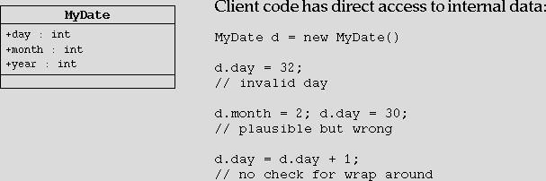
Information Hiding
The Problem:
Notes:
Information Hiding :
An object has a public interface that other objects can use to communicate with it. The object can maintain private information and methods that can be changed at any time without affecting the other objects that depend on it.
The class MyDate defined above, allows arbitrary access to its members from outside. It might result in an internal inconsistency of the members of the class.

Slide 55
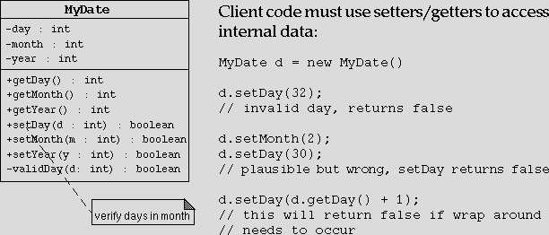
Information Hiding
The Solution:
Notes:
If the data members of a class are not exposed, the user of the class is forced to modify the class variables by using methods. These methods can perform validity checks.
In the example shown above, the method checks to see that the day it has been asked to set is valid. If the day is not valid, it ignored the request and prints a message.

Slide 56
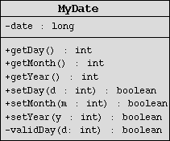
Encapsulation
Hides the implementation details of a class
Forces the user to use an interface to access data
Makes the code more maintainable
Notes:
Encapsulation
The localization of knowledge within a module. Because objects encapsulate data and implementation, the user of an object can view the object as a black box that provides services. Instance variables and methods can be added, deleted, or changed, but as long as the services provided by the object remain the same, code that uses the object can continue to use it without being rewritten.

Slide 57
Declaring Constructors
Basic syntax of a constructor:
<modifier> <class_name> (<parameter>*) {
<statement>*
}
Examples:
public class Thing {
private int x;
public Thing() {
x = 47;
}
public Thing(int new_x) {
x = new_x;
}
}
Notes:
Declaring Constructors
public class Thing {
private int x;
public Thing() {
x = 47;
}
public Thing(int new_x) {
x = new_x;
}
public int getX() {
return x;
}
public void setX(int new_x) {
x = new_x;
}
}

Slide 58
Notes:
Example usage:
public class TestThing {
public static void main(String[] args) {
Thing thing1 = new Thing();
Thing thing2 = new Thing(42);
System.out.println("thing1.x is " + thing1.getX());
System.out.println("thing2.x is " + thing2.getX());
}
}
Output:
thing1.x is 47
thing2.x is 42

Slide 59
The Default Constructor
There is always at least one constructor in every class
If the writer does not supply any constructors, the compiler generates a default constructor automatically. The default constructor takes no arguments
Enables you to create object instances with
new Xxx() without having to write a constructor
Notes:
The Default Constructor
Every class has at least one constructor. If you do not write a constructor, the Java programming language provides one for you. This constructor takes no argument and has no body.
The default constructor enables you to create object instances with new Xxx(); otherwise you would be required to provide a constructor for every class.
NOTE : If you add a constructor declaration with arguments to a class that previously had no explicit constructors, you loose the default constructor.

Slide 60
Summary
In this session, you learnt to:
Distinguish between analysis and design
Describe an abstract class
Describe the features of Object Oriented Programming

Slide 61
CHAPTER 4
Identifiers, Keywords and Types

Slide 62
Objective
At the end of this session, you will learn to:
Use three types of comments
Use all primitive types and String
Describe the parameter passing technique of java
Use the this keyword

Slide 63
Comments
Three permissible styles of comment in a Java program are:
[1] // comment on one line
[2] /* comment on one
or more lines */
[3] /** documentation comment */
Notes:
Comments
There are three permissible ways of inserting comments:
// comment on one line
/* comment on one or more lines */
/** documentation comment */
Documentation comments that are placed immediately before a declaration - of a variable, method or class; indicate that comment should be included in any automatically generated documentation (the HTML files generated by the javadoc command) to serve as a description of the declared item.

Slide 64
Primitive Types
The Java programming language defines eight primitive types:
  Logical - boolean
  Textual - char
  Integral - byte, short, int, and long
  Floating - double and float
Notes:
Basic Java Types :
Primitive Types
The Java programming language defines literal values for eight primitive data types and one class type i.e. String. The primitive types can be considered in four categories :
Logical boolean
Textual char
Integral byte, short, int, and long
Floating point double and float

Slide 65
Logical - boolean
The boolean data type has two literals, true and false.
For example, the statement:
    boolean truth = true;
declares the variable truth as boolean type, and assigns it a value of true.
Notes:
Logical - boolean
Logical values have two states: on or off, true or false, or yes or no. Such a value is represented by the boolean type. The boolean has two literal values: true or false.
NOTE : There are no casts between integer types and boolean type. Some languages like C and C++, allow numeric values to be interpreted as logical values. This is not permitted in Java.

Slide 66
Textual - char
char
Represents a 16-bit Unicode character
Must have its literal enclosed in single quotes(' ')
Uses the following notations:
  'a' The letter a
  ‘\t' A tab character
  ‘\u????' A specific Unicode character, ????, is replaced with exactly four hexadecimal digits (for example, '\u03A6' is the Greek letter phi)
Notes:
Textual - char
Single characters are represented by using a char type. A char represents a 16 - bit unsigned Unicode character. You must enclose a char literal in a single quotes (‘ ‘).

Slide 67
String
Is not a primitive data type; it is a class
Has its literal enclosed in double quotes (" ")
  "The quick brown fox jumps over the lazy dog."
Can be used as follows:
  String greeting = "Good Morning !! \n";
  String errorMessage = "Record Not Found !";
Notes:
The String type, which is not a primitive but a class, is used to represent sequences of characters. The characters themselves are Unicode and the backslash notation shown above for the char type also works on a String.
NOTE : Unlike C/C++ Strings do not end with \0.
A String literal is enclosed in double quote marks:
“The quick brown fox jumps over the lazy dog.”
Some examples of the declarations and initialization of char and String type variables are:
// declares and initializes a char variable
char ch = ‘A’;
// declares two char variables
char ch1, ch2;
// declares two String variables and initializes them
String s1 = “Hello!! \n”;
String err = “File Not Found !”;
// declares two String variables
String str1, str2;

Slide 68
Integral - byte, short, int and long
Uses three forms - Decimal, octal, or hexadecimal
  2 The decimal value is two
  077 The leading zero indicates an octal value
  0xBAAC The leading 0x indicates a hexadecimal value
Has a default int
Defines long by using the letter L or l
Notes:
Integral - byte, short, int, and long
There are four integral types in the Java programming language. Each type is declared using one of the keywords byte, short, int, or long. You can represent literals of integral types using decimal, octal, or hexadecimal forms as follows :
2 The decimal value is two.
077 The leading zero indicates an octal value.
0xBAAC The leading 0x indicates a hexadecimal value.
NOTE : All integral types in the Java programming language are signed numbers.
NOTE : Integral literals are of type int unless explicitly followed by the letter “L”, which indicates a long value

Slide 69
Integral - byte, short, int, and long
Integral data types have the following ranges :
Name / Type
Length
Range
byte
8 bits
-2⁷ to 2⁷-1
short
16 bits
-2¹⁵ to 2¹⁵ -1
int
32 bits
-2³¹ to 2³¹ -1
long
64 bits
-2⁶³ to 2⁶³ -1
Notes:
The size and range of the four integral types are shown in the table above. The range representation is defined by the Java programming language specification as a two’s complement and is platform independent.

Slide 70
Floating Point - float and double
Default is double
Floating point literal includes either a decimal point, or one of the following:
  E or e (add exponential value)
  F or f (float)
  D or d (double)
    3.14 A simple floating-point value (a double)
    6.02E23 A large floating-point value
    2.718F A simple float size value
    123.4E+306D A large double value with redundant
Notes:
Floating Type - float and double
You can declare a floating type variable using the keyword float or double. A numeric literal is floating point if it includes either a decimal point or an exponent part (the letter E or e), or is followed by the letter F or f(float) or the letter D or d (double).
NOTE : Floating point literals are double unless explicitly declared as float.

Slide 71
Java Reference Types
Beyond primitive types, all others are reference types
A reference variable contains a "handle" to an object
Example:
1 public class MyDate {
2 private int day;
3 private int month;
4 private int year;
5 }
1 public class TestMyDate {
2 public static void main(String[] args) {
3 MyDate today = new MyDate();
4 }
5 }
Notes:
Creating a new type
The java programming language uses a class to create new types. Consider the following primitive type declaration:
int day;
you use the java programming language to allocate a certain amount of storage and interpret the contents of that storage. So, to define a new type, you must specify how much storage is required and how to interpret the contents.This is done not in terms of numbers of bytes or ordering and meaning of bits, but in terms of other types that are already defined.
For example, to define a type that represents a date, you need enough storage for three integers. Furthermore, the significance of day, month, and year is attributed to these integers. For example:
class MyDate {
int day;
int month;
int year;
}
The word class is a keyword in the java programming language and must be written in lowercase. In the name MyDate, M and D are capitalized by convention rather than by language requirement.

Slide 72
Constructing and Initializing Objects
Calling new Xxx() to allocate space for the new object results in:
  Memory Allocation: Space for the new object is allocated and instance variables are initialized to their default values (e.g. 0, false, null, and so on)
  Explicit attribute initialization is performed
  A constructor is executed
  Variable assignment is made to reference the object
Example:
  MyDate today = new MyDate();
Notes:
Creating a new Type(Continued)
You can declare a variable as being of type MyDate. For example:
MyDate myBirth, yourBirth;
You can initialize them using :
myBirth=new MyDate();
yourBirth=new MyDate();
Using this declaration, the java programming language allows the parts (day, month, and year) of the variables, called the members, to be accessed using the dot (.) operator. For example:
myBirth.day = 26;
myBith.month = 11;
yourBirth.year = 1960;

Slide 73
Notes:
Memory Allocation and Layout :
Declaration allocates storage only for a reference :
For example,
Date today;
Today =
Use new operator to allocate space for date and initialize attributes:
today =new Date();
today = day
month
year
????
12xx43
0
0
0

Slide 74
Assignment of reference variables
int x = 7;
int y = x;
String s = “Hello”;
String t = s;
x
y
s
t
7
7
0x01234
0x01234
Hello

Slide 75
Pass-by-Value
The Java programming language only passes arguments by value for primitive data types.
When an object instance is passed as an argument to a method, the value of the argument is a reference to the object
The contents of the object can be changed in the called method, but the object reference is never changed
Notes:
The Java programming language only passes arguments by value.
When an object instance is passed as an argument to a method, the value of the argument is a reference to the object.
The contents of the object can be changed in the called method, but the object reference is never changed .

Slide 76
Notes:
public class PassTest {
float ptValue;
// Methods to change the current values
public void changeInt(int value) {
value = 55;
}
public void changeStr(String value) {
value = new String("Different");
}
public void changeObjValue(PassTest ref) {
ref.ptValue = 99.0F;
}
public static void main(String [] args) {
String str;
int val;
// Create an instance of the class
PassTest pt = new PassTest();
// Assign the int
val = 11;
//Try to change it
pt.changeInt(val);
//What is the current value
System.out.println("Int value is : " + val);

Slide 77
Notes:
// Assign the String
str = new String("Hello");
// Try to change it
pt.changeStr(str);
//What is the current value
System.out.println("str value is : " + str);
// Now set the ptValue
pt.ptValue = 101.0f;
// Change the value through object reference
pt.changeObjValue(pt);
//What is the current value
System.out.println("ptValue is : " + pt.ptValue);
}
}

Slide 78
The this Reference
Refers to the object on which the method operates.
Can be used to pass the current object as reference.
In a constructor, the this keyword takes on a different meaning when you give it an argument list:
  it makes an explicit call to the constructor that matches that argument list.
Notes:
Refers to the object on which the method operates.
Can be used to pass the current object as reference.
In a constructor the this keyword takes on a different meaning when you give it an argument list : it makes an explicit call to the constructor that matches that argument list.

Slide 79
Summary
In this session, you learnt to:
Use three types of comments
Use all primitive types and String
Describe the parameter passing technique of java
Use the this keyword

Slide 80
CHAPTER 5
Inheritance and Advanced class Features

Slide 81
Objective
In this session, you will learn to:
Describe the inheritance model of java
Distinguish between overloading and overriding
State the rules regarding overriding
Use super keyword
Use wrapper class and describe its importance
State and use the different access specifiers and modifiers

Slide 82
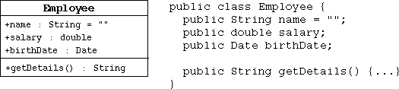
The ‘is a’ Relationship
The Employee class:
Notes:
The ‘is a’ Relationship
In programming you often create a model of something and then need a more specialized version of that original model. For example you might want to model for a manager. Clearly a manager is actually an employee with some additional features.
Consider the following class declaration :
public class Employee {
String name;
Date hireDate;
Date dateOfBirth;
. . . . .
. . . . .
}

Slide 83
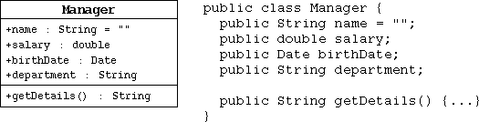
The ‘is a’ Relationship
The Manager class:
Notes:
The ‘is a’ Relationship (Continued)
public class manager {
String name;
Date hireDate;
Date dateOfBirth;
String jobTitle;
int grade;
String department;
Employee sunbordinates[];
. . . . . .
. . . . . .
}
This example illustrates the duplication of data between the Manager class and the Employee class. Additionally there will be a number of methods that would be applicable to both Employee and Manager. Therefore, you need a way to create a new class from an existing class; this is called subclassing.

Slide 84
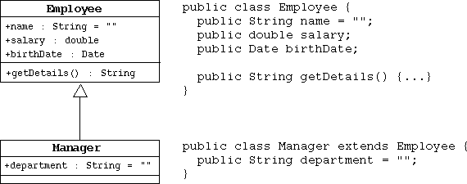
The ‘is a’ Relationship
The ‘is a’ Relationship :
Notes:
The extends keyword
In Object Oriented languages, special mechanisms are provided that allow the programmer to define a class in terms of a previously defined class. This is achieved using the extends keyword, as follows :
public class Employee {
String name;
Date hireDate;
Date dateOfBirth;
String jobTitle;
int grade;
. . . . .
}
public class Manager extends Employee {
String department;
Employee subordinates[];
. . . .
. . . .
}

Slide 85
Single Inheritance
When a class inherits from only one class, it is called single inheritance .
Single inheritance makes code more reliable.
Interfaces provide the benefits of multiple inheritance without drawbacks.
Syntax of a Java class:
<modifier> class <name> [extends superclass] {
<declarations>*
}
Notes:
Single Inheritance
The Java programming language allows a class to extend only one class. Java imposes the single inheritance restriction to make the resulting code more reliable, although this sometimes means more work for the programmer.

Slide 87
Constructors Are Not Inherited
A subclass inherits all methods and variables from the superclass (parent class)
A subclass does not inherit the constructor from the superclass
Two ways to include a constructor are:
  Use the default constructor
  Write one or more explicit constructors
Notes:
Constructors Are Not Inherited
Although a subclass inherits all of the methods and variables from a superclass (parent class), it does not inherit constructors.
There are two ways that a class can gain a constructor; either you write the constructor, or, because you have not written any constructors, the class has a single default constructor.
NOTE : A parent class constructor is always called in addition to a child class constructor.

Slide 88
Polymorphism
Polymorphism is the ability to have many different forms; for example, the Manager class has access to methods from Employee class
An object has only one form
A reference variable can refer to objects of different forms
Notes:
Polymorphism
Describing a Manager as an Employee is not just a convenient way of describing the relationship between these two classes. Recall that the Manager has all the attributes, both member variables and methods, of the parent class Employee. This means that any operation that is legitimate on an Employee is also legitimate on a Manager. If the Employee has methods raiseSalary ( ) and fire( ), then the Manager class does also.
An object has only one form (the one that is given to it when constructed). However, a variable is polymorphic because it can refer to objects of different forms. In the Java programming language, there is one class that is a parent class for all others, java.lang.Object class. So, in effect, earlier definitions were shorthand for the following:
public class Employee extends Object and
public class Manager extends Employee

Slide 89
Polymorphism
Employee employee = new Manager() // legal
// Illegal attempt to assign Manager attribute
employee. department = "Sales";
//the variable is declared as a Employee type, even though the Manager object has that attribute
Notes:
polymorphism (Continued)
The Object class defines a number of useful methods, including toString( ), which is why, every object in java can be converted to a string representation (even if the result is of limited use).
The Java programming language,like most object-oriented languages, actually allows you to refer to an object with a variable that is one of the parent class types. So you can say:
Employee e = new Manager ( ) ;
Using the variable e as is, you can access only the parts of the object that are part of an Employee; the Manager-specific parts are hidden. This is because as far as the compiler is concerned, e is an Employee, not a Manager. Therefore, the following is not allowed:
// Illegal attempt to assign a value to a member
// variable of Manager class when reference is of type parent(Employee) class :
e .department = "Finance " ;

Slide 90
Heterogeneous Collections
Collections of objects with the same class type are called homogenous collections.
  MyDate[] dates = new MyDate[ 2];
  dates[ 0] = new MyDate( 22, 12, 1964);
  dates[ 1] = new MyDate( 22, 7, 1964);
Collections of objects with different class types are called heterogeneous collections.
  Employee [] staff = new Employee[ 1024];
  staff[ 0] = new Manager();
  staff[ 1] = new Employee();
  staff[ 2] = new Engineer();
Notes:
Heterogeneous Collections
You can create collections of objects that have a common class. Such collections are called homogeneous collections.
The Java programming language has an Object class, so you can make collections of all kinds of objects due to polymorphism, as all classes extend class Object. Such a collection is called a heterogeneous collection.
It might seem unrealistic to create a Manager and deliberately assign the reference to it to a variable of type Employee. This is possible and there are reasons why you might want to achieve this effect.
E.g.
Employee [] staff = new Employee[10];
staff[0] = new Manager();
staff[1] = new Employee();

Slide 91
The instanceof Operator
public class Employee extends Object
public class Manager extends Employee
public class Engineer extends Employee
-------------------------------------------------
public void doSomething( Employee e) {
if (e instanceof Manager) {
// Process a Manager
} else if (e instanceof Engineer) {
// Process an Engineer
} else {
// Process any other type of Employee
}
}
Notes:
The instanceof Operator
Given that you can pass objects around using references to their parent classes, sometimes you might want to know what you actually have. This is the purpose of instanceof operator. Consider the following class hierarchy :
public class Employee extends Object
public class Manager extends Employee
public class Contractor extends Employee
If you receive an object using a reference of type Employee, it might turn out to be a Manager or Contractor. You can test this using instanceof operator :
public void doSomething( Employee e) {
if (e instanceof Manager) {
// Process a Manager
} else if (e instanceof Engineer) {
// Process an Engineer
} else {
// Process any other type of Employee
}
}

Slide 92
Casting Objects
Use instanceof to test the type of an object
Restore full functionality of an object by casting
Check for proper casting using the following guidelines:
  Casts up hierarchy are done implicitly
  Downward casts must be to a subclass and checked by the compiler
  The object type is checked at runtime when runtime errors can occur
Notes:
Casting Objects
In circumstances where you have received a reference to a parent class, and you have determined that the object is actually a particular subclass by using the instanceof operator, you can restore the full functionality of the object by casting the reference.
public void method(Employee e) {
if(e instanceof Manager) {
Manager m = (Manager) e;
// Manager logic
}
// rest of the logic
}
If you do not make the cast, an attempt to reference e.department would fail the compiler can not locate a member called department in the Employee class.

Slide 93
Overriding Methods
A subclass can modify behavior inherited from a parent class
A subclass can create a method with different functionality than the parent’s method but with the same:
  Name
  Return type
  Argument list
Notes:
Overriding Methods
In addition to being able to produce a new class based on an old one by adding additional features, you can modify the existing behavior of the parent class.
If a method is defined in a new class such that the name, return type, and the argument type exactly match those of a method in the parent class, the new method is said to override the old one.
NOTE : Methods with the same name but different argument list that are in the same class, are simply overloaded. This causes the compiler to use the supplied arguments to determine which method to call.

Slide 94
Notes:
Overriding Methods
public class Employee {
protected String name;
protected double salary;
protected Date birthDate;
public String getDetails() {
return "Name: " + name + "\n" + "Salary: " + salary;
}
}
public class Manager extends Employee {
protected String department;
public String getDetails() {
return "Name: " + name + "\n" + "Salary: " + salary + "\n" +
"Manager of: " + department;
}
}
The Manager class has a getDetails() method by definition because it inherits one from the Employee class. However, the original method has been replaced, or overriden, by the child class’s version.

Slide 95
Overriding Methods
Virtual method invocation:
  Employee e = new Manager();
  e. getDetails();
Static and Dynamic
Notes:
Overriding Methods
Assume that the example on the previous page and the following scenario are true :
Employee e = new Employee();
Manager m = new Manager();
If you ask for e.getDetails() and m.getDetails(), you invoke different behaviors. The Employee object executes the version of getDetails() associated with Employee class and the Manager object executes the one associated with the Manager class.
What is less obvious is what happens if you have :
Employee e = new Manager();
e.getDetails();
You get the behavior associated with the runtime type of the variable, not the behavior associated with compile time of the variable. This is often referred as virtual method invocation.

Slide 96
Rules About Overridden Methods
Must have a return type that is identical to the method it overrides.
Cannot be less accessible than the method it overrides.
Cannot throw more exceptions than the method it overrides.
Notes:
Rules About Overridden Methods
Remember that the method name, and order of arguments of a child method must be identical to those of the method in the parent class for that method to override the parent’s version. The following rules apply to overridden methods :
The return type of the overriding method must be identical to the method it overrides.
An overriding method can not be less accessible than the method it overrides.
An overriding method can not throw different types exceptions than the method it overrides.

Slide 97
Notes:
Rules About Overridden Methods (continued)
These rules result from the nature of polymorphism combined with the need for the Java programming language to be type safe.
Consider the following example :
public class Parent {
public void method() {}
}
public class Child extends Parent {
private void method() {}
}
The Java programming language dictate that method() defined in Child class should not be less accessible than the method() defined in Parent class. The above example clearly disobeys this rule and hence results in a compile time error.

Slide 98
The super keyword
super is used in a class to refer to its superclass
super is used to refer to the members of superclass, both data attributes and methods
Behavior invoked does not have to be in the superclass; it can be further up in the hierarchy
Notes:
The super Keyword
The super keyword refers to the superclass of the class in which the keyword is used. It is used to refer to the member variables or the methods of the superclass.
Quite often when you override a method, your real goal is not to replace the existing behavior but to extend the behavior in some way. In such cases, you can refer to the superclass’ method by using super keyword.
For example,

Slide 99
Notes:
The super Keyword (Continued)
public class Employee {
private String name;
private double salary;
private Date birthDate;
public String getDetails() {
return Name: " + name + "\ nSalary: " + salary;
}
}
public class Manager extends Employee {
private String department;
public String getDetails() {
// call parent method
return super. getDetails() + "\ n" +"Manager of: " + department;
}
}
A call of the form super.method() invokes the entire behavior, along with any side effects of the method that would have been invoked if the object had been of type parent class. The method does not have to be defined in that parent class; it could be inherited from some class further up the hierarchy.

Slide 100
Invoking Parent Class Constructors
To invoke a parent constructor you must place a call to super in the first line of the constructor
You can call a specific parent constructor by the arguments that you use in the call to super
If no this or super call is used in a constructor, then the compiler adds an implicit call super() which calls the parent "default" constructor
  Compile time error will be generated, if the parent class does not supply a non- private "default" constructor.
Notes:
1 public class Employee {
2 private static final double BASE_SALARY = 15000.00;
3 private String name;
4 private double salary;
5 private Date birthDate;
6
7 public Employee(String name, double salary, Date dateOfBirth) {
8 this.name = name;
9 this.salary = salary;
10 this.birthDate = dateOfBirth;
11 }
12 public Employee(String name, double salary) {
13 this(name, salary, null);
14 }

Slide 101
Notes:
15 public Employee(String name, Date dateOfBirth) {
16 this(name, BASE_SALARY, dateOfBirth);
17 }
18 public Employee(String name) {
19 this(name, BASE_SALARY);
20 }
21 // more Employee code...
22 }
1 public class Manager extends Employee {
2 private String department;
3
4 public Manager(String name, double salary, String dept) {
5 super(name, salary);
6 department = dept;
7 }
8 public Manager(String n, String dept) {
9 super(name);
10 department = dept;
11 }
12 public Manager(String dept) { // This code fails: no super()
13 department = d;
14 }
15 }

Slide 102
Overloading Method Names
It can be used as follows:
  public void println( int i)
  public void println( float f)
  public void println( String s)
Argument lists must differ
Return types can be different
Notes:
Overloading Method Names
In some circumstances, you might want to write several methods in the same class that do basically the same job with different arguments. Java allows you to reuse a method name for more than one method. This can work only if there is something in the circumstances under which the method call is made that will distinguish the method that is actually needed. Following rules apply to overloaded methods :
The argument list of the calling statements must differ enough to allow unambiguous determination of the proper method to call. Normal widening promotions might be applied, causing confusion in some cases.
The return type of the methods can be different, but it is not sufficient for the return type to be the only difference.

Slide 103
Overloading Constructors
As with methods, constructors can be overloaded
Example:
  public Employee( String name, double salary, Date date)
  public Employee( String name, double salary)
  public Employee( String name, Date date)
Argument lists must differ
The this reference can be used at the first line of a constructor to call another constructor
Notes:
1 public class Employee {
2 private static final double BASE_ SALARY = 15000.00;
3 private String name;
4 private double salary;
5 private Date birthDate;
6
7 public Employee( String name, double salary, Date date) {
8 this. name = name;
9 this. salary = salary;
10 this. birthDate = date;
11 }
12 public Employee( String name, double salary) {
13 this( name, salary, null);
14 }
15 public Employee( String name, Date date) {
16 this( name, BASE_ SALARY, date);
17 }
18 public Employee( String name) {
19 this( name, BASE_ SALARY);
20 }
21 // more Employee code...
22 }

Slide 104
Constructing and Initializing Objects: A Slight Reprise
Memory is allocated and default initialization occurs
Instance variable initialization uses these steps recursively:
  1 Bind constructor parameters.
  2 If explicit this(), call recursively and then skip to step 5.
  3 Call recursively the implicit or explicit super(), except for Object .
  4 Execute explicit instance variable initializers.
  5 Execute body of current constructor.

Slide 105
An Example
public class Employee extends Object {
private String name;
private double salary = 15000.00;
private Date birthDate;
public Employee(String n, Date date) {
// implicit super();
name = n;
birthDate = date;
}
public Employee(String n) {
this(n, null);
}
}
Notes:
0 basic initialization
0.1 allocate memory for the complete Manager object
0.2 initialize all instance variables to their default values
1 call constructor: Manager("Joe Smith", "Sales")
1.1 bind constructor parameters: n="Joe Smith", d="Sales"
1.2 no explicit this() call
1.3 call super(n) for Employee(String)
1.3.1 bind constructor parameters: n="Joe Smith"
1.3.2 call this(n, null) for Employee(String, Date)
1.3.2.1 bind constructor parameters: n="Joe Smith", date=null
1.3.2.2 no explicit this() call
1.3.2.3 call super() for Object()
1.3.2.3.1 no binding necessary
1.3.2.3.2 no this() call
1.3.2.3.3 no super() call (Object is the root)
1.3.2.3.4 no explicit variable initialization for Object
1.3.2.3.5 no method body to call

Slide 106
An Example
public class Manager extends Employee {
private String department;
public Manager(String n, String d) {
super(n);
department = d;
}
}
Notes:
1.3.2.4 initialize explicit Employee variables: salary=15000.00;
1.3.2.5 execute body: name="Joe Smith"; birthDate=null;
1.3.3 - 1.3.4 steps skipped
1.3.5 execute body: no body in Employee(String)
1.4 no explicit initializers for Manager
1.5 execute body: department="Sales“
Example:
public class Test{
public static void main(String args[]){
Manager m=new Manager(“Joe Smith”,”Sales”);
}
}

Slide 107
Notes:
1.3.2.4 initialize explicit Employee variables: salary=15000.00;
1.3.2.5 execute body: name="Joe Smith"; birthDate=null;
1.3.3 - 1.3.4 steps skipped
1.3.5 execute body: no body in Employee(String)
1.4 no explicit initializers for Manager
1.5 execute body: department="Sales“
Example:
public class Test{
public static void main(String args[]){
Manager m=new Manager(“Joe Smith”,”Sales”);
}
}

Slide 108
The Object Class
The Object class is the root of all classes in Java
A class declaration with no extends clause, implicitly uses "extends Object“
public class Employee {
...
}
is equivalent to:
public class Employee extends Object {
...
}
Notes:
The class Object is the root of the class hierarchy. Every class has Object as a superclass. All objects, including arrays, implement the methods of this class.
Important Methods :
public boolean equals(Object obj)
Indicates whether some other object is "equal to" this one.
protected Object clone() throws CloneNotSupportedException
Creates and returns a copy of this object.
public String toString()
Returns a string representation of the object. In general, the toString method returns a string that "textually represents" this object.
protected void finalize() throws Throwable
Called by the garbage collector on an object when garbage collection determines that there are no more references to the object.

Slide 109
Wrapper Classes
Look at primitive data elements as objects
Primitive Data Type Wrapper Class
boolean Boolean
byte Byte
char Character
short Short
int Integer
long Long
float Float
double Double
Notes:
Examples :
int pInt = 500;
Integer wInt = new Integer( pInt);
int p2 = wInt. intValue();

Slide 110
Access specifiers and modifiers
  private
    - can be accessed only within the declaring class
  protected
    - can be accessed in the declaring class as well as derived class, and all other classes in the same package
  default
    - package scope
  public
    - global scope
Notes:
private
The most restrictive access level is private. A private member is accessible only to the class in which it is defined. Use this access to declare members that should only be used by the class. This includes variables that contain information that if accessed by an outsider could put the object in an inconsistent state, or methods that, if invoked by an outsider, could jeopardize the state of the object or the program in which it's running.
protected
The next access level specifier is protected, which allows the class itself, subclasses (with the caveat that we referred to earlier), and all classes in the same package to access the members.
public
The easiest access specifier is public. Any class, in any package, has access to a class's public members. Declare public members only if such access cannot produce undesirable results if an outsider uses them.
package
The package access level is what you get if you don't explicitly set a member's access to one of the other levels. This access level allows classes in the same package as your class to access the members. This level of access assumes that classes in the same package are trusted friends.

Slide 111
Access specifiers and modifiers
static
  only one copy exists for the entire class.
  static methods and blocks may access only static data members.
  static methods and blocks can call only static methods.
  static methods do not have access to this reference.
Notes:
static
Java technology defines away of sharing data between objects, on a class scope basis. Such data is not bound to an instance nor stored in one, but to a class. Such methods and data are declared as static. No instances are needed to use static methods or data of a class, although they can be accessed through them.

Slide 112
Access specifiers and modifiers
final
  variables must be initialized and cannot change their value.
  methods cannot be overridden.
  arguments can only be read, their value cannot be changed.
  classes can not be inherited.
transient
  cannot be serialized.
Notes:
final variables :
You can declare a variable in any scope to be final. The value of a final variable cannot change after it has been initialized. Such variables are similar to constants in other programming languages.
Ex. final int aFinalVar = 0;
The previous statement declares a final variable and initializes it, all at once. Subsequent attempts to assign a value to aFinalVar result in a compiler error. You may, if necessary, defer initialization of a final variable. Simply declare the variable and initialize it later, like this:
final int blankFinal;
. . .
blankFinal = 0;
transient
The transient marker is not fully specified by The Java Language Specification but is used in object serialization to mark member variables that should not be serialized.

Slide 113
Access specifiers and modifiers
synchronized
  A single thread of execution exists for a synchronized method or block.
  Used to obtain the lock for an object.
native
  If a method has been declared using the native keyword in a java source file, it means that the method definition will be appearing in some external library.
volatile
  Optimization not done by the compiler.
Notes:
synchronized
Concurrently running threads often invoke methods that operate on the same data. These methods may be declared synchronized to ensure that the threads access information in a thread-safe manner.
native
If you have a significant library of functions written in another language such as C, you may wish to preserve that investment and use those functions from Java. Methods implemented in a language other than Java are called native methods and are declared as such using the native keyword.
volatile
The volatile keyword is used to prevent the compiler from performing certain optimizations on a member variable.

Slide 114
Notes:
To make your classes more acceptable in well mannered OOP circles :
Always keep data private.
When data are kept private, changes in their representation do not effect the user of the class, and bugs are easier to detect.
Always initialize data.
It’s always a good programming practice to initialize the variables explicitly either by supplying a default or by settings defaults in all constructors.
Don’t use too many basic types in a class.
The idea is to replace multiple related use of basic types with other types. This keeps classes easier to understand and to change.
Not all fields need individual field accessors and mutators.
Quite often objects have instance variables that you don’t want others to get or set.
Break up classes with too many responsibilities.
If there is an obvious way to make one complicated class into two classes that are conceptually simpler, seize the opportunity.
Make the names of your classes and methods reflect their responsibilities.
Class names should be nouns or nouns preceded by an adjective, eg. Order or RushOrder.
Method names should be verbs.
Accessor methods should begin with a lowercase get.
Mutator methods should begin with a lowercase set.

Slide 115
Summary
In this session, you learnt to:
Describe the inheritance model of java
Distinguish between overloading and overriding
State the rules regarding overriding
Use super keyword
Use wrapper class and describe its importance
State and use the different access specifiers and modifiers

Slide 116
CHAPTER 6
Packages and Interfaces

Slide 117
Objective
At the end of this session, you will learn to:
Define a package
Create and use a package
Define an interface
Create and use an interface
Describe the Cloneable inteface

Slide 118
Packages
Packages are containers, used to keep the class namespace compartmentalized.
The Package declaration, if any, must be at the beginning of the source file and can be preceded only by whitespaces and comments.
package package1;
public class SomeClass {
// class body
}
SomeClass.java
Notes:
To make classes easier to find and to use, to avoid naming conflicts, and to control access, programmers bundle groups of related classes and interfaces into packages.
A package is a collection of related classes and interfaces providing access protection and namespace management.
The classes and interfaces that are part of the Java platform are members of various packages that bundle classes by function: fundamental classes are in java.lang, classes for reading and writing (input and output) are in java.io, and so on. You can put your classes and interfaces in packages, too.
You should bundle the related classes and the interfaces in a package for several reasons:
You and other programmers can easily determine that these classes and interfaces are related. .
The names of your classes wont conflict with class names in other packages, because the package creates a new namespace.
You can allow classes within the package to have unrestricted access to one another yet still restrict access for classes outside the package.

Slide 119
Packages
Only one package declaration is permitted, and it governs the entire source file.
Packages are stored in a hierarchical manner, and are explicitly imported into new class definitions.
The CLASSPATH variable controls the specific location that the Java compiler looks for as the root of any package.
The import statement is used to bring classes in other packages into the current namespace.
Notes:
The scope of the package statement is the entire source file. So, for example, all classes and interfaces defined in Circle.java and Rectangle.java are also members of the graphics package, as long as, Circle.java and Rectangle.java, the two files are in graphics package. If you put multiple classes in a single source file, only one may be public, and it must share the name of the source files base name. Only public package members are accessible from outside the package.
Many implementations of the Java platform rely on hierarchical file systems to manage source and class files, although The Java Language Specification does not require this.
The qualified name of the package member and the path name to the file are parallel, assuming the UNIX file name separator slash (/):
class name graphics.Rectangle
pathname to file graphics/Rectangle.java
Why all the bother about directories and file names? You need to manage your source and class files in this manner so that the compiler and the interpreter can find all the classes and interfaces your program uses. When the compiler encounters a new class as it is compiling your program, it must be able to find the class so as to resolve names, do type checking, and so on. Similarly, when the interpreter encounters a new class as its running your program, it must be able to find the class to invoke its methods, and so on. Both the compiler and the interpreter search for classes in each directory or ZIP file listed in your classpath.

Slide 120
Creating Packages
package account;
public class Balance {
String name;
double bal;
public Balance( String n, double b ) {
name = n;
bal = b;
}
public void show( ) {
if ( bal < 0 )
System.out.println ( "---->” );
System.out.println ( name + " : $ " + bal );
}
}
Notes:
A classpath is an ordered list of directories or ZIP files in which to search for class files.
If you do not use a package statement, your class or interface ends up in the default package, which is a package that has no name. Generally speaking, the default package is only for small or temporary applications or when you are just beginning development. Otherwise, classes and interfaces belong in named packages.
Naming Convention: Companies use their reversed Internet domain name in their package names, like this: com.company.package. Some companies now choose to drop the first element com. in this example from their package names. Name collisions that occur within a single company need to be handled by convention within that company, perhaps by including the region or the project name after the company name, for example, com.company.region.package.

Slide 121
Accessing Packages
import account.*;
public class AccountBalance {
public static void main(String [] args) {
Balance current[] = new Balance[3];
current[0] = new Balance(”Tom",12.12);
current[1] = new Balance("Mary",22.12);
current[2] = new Balance("Jack",32.12);
for ( int i = 0;i < 3;i++ )
current[i].show();
}
}
Notes:
Only public package members are accessible outside the package in which they are defined. To use a public package member from outside its package, you must do one or more of the following:
Refer to the member by its long (qualified) name
account.Balance current= new account.Balance();
Import the package member
import account.Balance;
Import the members of the entire package
import account.*;

Slide 122
Interfaces
Allow to fully abstract a classes’ interfaces from their implementations.
Pure abstract classes with no implementation of any method.
Only methods and constant declarations are allowed within an interface.
Classes implement interfaces.
Once defined, any number of classes can implement an interface.
Notes:
The Java programming language supports interfaces that you use to define a protocol of behavior that can be implemented by any class anywhere in the class hierarchy. An interface declares a set of methods but does not implement them. A class that implements the interface agrees to implement all the methods declared in the interface, thereby agreeing to certain behavior.
An interface is a named collection of method declarations (without implementations). An interface can also declare constants.
Because an interface is simply a list of unimplemented, and therefore abstract, methods, you might wonder how an interface differs from an abstract class. The differences are significant.
An interface cannot implement any methods, whereas an abstract class can.
A class can implement many interfaces but can have only one superclass.
An interface is not part of the class hierarchy. Unrelated classes can implement the same interface.

Slide 123
Defining an Interface
access interface name {
return-type method-name1(argument list);
………………..
return-type method-nameN(argument list);
type final-varname1 = value;
type final-varname2 = value;
…………………
type final-varnameN = value;
}
Notes:
Two elements are required in an interface declaration--the interface keyword and the name of the interface. The public access specifier indicates that the interface can be used by any class in any package. If you do not specify that your interface is public, your interface will be accessible only to classes that are defined in the same package as the interface.
An interface declaration can have one other component: a list of superinterfaces. An interface can extend other interfaces, just as a class can extend or subclass another class. However, whereas a class can extend only one other class, an interface can extend any number of interfaces. The list of superinterfaces is a comma-separated list of all the interfaces extended by the new interface.
The interface body contains method declarations for all the methods included in the interface. A method declaration within an interface is followed by a semicolon (;) because an interface does not provide implementations for the methods declared within it. All methods declared in an interface are implicitly public and abstract.

Slide 124
Defining an Interface
access is either public or not used, the default access has package scope.
methods are essentially abstract methods.
Variables are public, final and static and can not be changed by the implementing classes.
All methods and variables are implicitly public even if the interface itself is not declared as public.
Notes:
An interface can contain constant declarations in addition to method declarations. All constant values defined in an interface are implicitly public, static, and final.
Member declarations in an interface disallow the use of some declaration modifiers; you cannot use transient, volatile, or synchronized in a member declaration in an interface. Also, you may not use the private and protected specifiers when declaring members of an interface

Slide 125
The Cloneable Interface
class Day implements Cloneable
{
…
}
-------------------------------------------------------
Day bDay = new Day(1999,6,16);
Day d = bDay;
d.advance(100);
------------------------------------------------------
Day bDay = new Day(1999,6,16);
Day d = (Day)bDay.clone();
d.advance(100);
Notes:
When a class implements an interface, it is essentially signing a contract. Either the class must implement all the methods declared in the interface and its superinterfaces, or the class must be declared abstract. The method signature--the name and the number and type of arguments in the class--must match the method signature as it appears in the interface.
A class implements the Cloneable interface to indicate to the object.clone() method that it is legal for that method to make a field-for-field copy of instances of that class.
Attempts to clone instances that do not implement the Cloneable interface result in the exception CloneNotSupportedException being thrown.
The interface Cloneable declares no methods

Slide 126
Summary
In this session, you learnt to:
Define a package
Create and use a package
Define an interface
Create and use an interface
Describe the Cloneable inteface

Slide 127
CHAPTER 7
Exception Handling

Slide 128
Objective
At the end of this session, you will be able to:
Distinguish between Error and Exception
Distinguish between checked and unchecked exceptions
Use try, catch and finally blocks
Use throw and throws keywords.
Describe the flow of control with/without exceptions and with/without appropriate handlers

Slide 129
Exception Handling
User Input Error
Device Error
Physical Limitation
Code Errors
Notes:
An exception is an event that occurs during the execution of a program that disrupts the normal flow of instructions.
Any abnormal condition that disturbs the normal program flow while the program is in execution is an error or an exception.
The errors are serious conditions from which we better avoid recovery of the program.
Exceptions are mild error conditions and rather than
terminating the program we can handle such exceptions and continue program execution.
User input errors -
This is some incorrect data entered by the user
Device error-
The hardware may have some problems which need to be reported to the user. For example, printer may be off, printer out of paper or it has failed during the execution itself
Physical limitation-
Program runs out of available memory or Hard disk is full.
Code errors-
A method may not perform correctly.

Slide 130
Exception Handling
java.lang.Object
java.lang.Throwable
java.lang.Error
java.lang.Exception
java.io.IOException
java.lang.RuntimeException
Notes:
The class Object is the root of the class hierarchy. Every class has Object as a superclass. All objects, including arrays, implement the methods of this class.
The Throwable class is the superclass of all errors and exceptions in the Java language. Only objects that are instances of this class (or of one of its subclasses) are thrown by the Java Virtual Machine or can be thrown by the Java throw statement. Similarly, only this class or one of its subclasses can be the argument type in a catch clause.
An Error is a subclass of Throwable that indicates serious problems that a reasonable application should not try to catch. Most such errors are abnormal conditions. The ThreadDeath error, though a "normal" condition, is also a subclass of Error because most applications should not try to catch it.
The class Exception and its subclasses are a form of Throwable that indicates conditions that a reasonable application might want to catch.
RuntimeException is the superclass of those exceptions that can be thrown during the normal operation of the Java Virtual Machine. A method is not required to declare in its throws clause any subclasses of RuntimeException that might be thrown during the execution of the method but not caught.
IOException signals that an I/O exception of some sort has occurred. This class is the general class of exceptions produced by failed or interrupted I/O operations.

Slide 131
Exception Handling
Error
  Indicates a severe problem from which recovery is difficult,
  if not impossible. eg. running out of memory.
RuntimeException
  - Indicates a design or implementation error.
Notes:
When a dynamic linking failure or some other "hard" failure in the virtual machine occurs, the virtual machine throws an Error. Typical Java programs should not catch Errors. In addition, it's unlikely that typical Java programs will ever throw Errors either.
The run time exceptions represent problems that are detected by the runtime system. This includes arithmetic exceptions (such as when dividing by zero), pointer exceptions (such as trying to access an object through a null reference), and indexing exceptions (such as attempting to access an array element through an index that is too large or too small).
Run time exceptions can occur anywhere in a program and in a typical program can be very numerous. Typically, the cost of checking for runtime exceptions exceeds the benefit of catching or specifying them. Thus the compiler does not require that you catch or specify runtime exceptions, although you can.
Because run time exceptions are so ubiquitous and attempting to catch or specify all of them all the time would be a fruitless exercise (and a fruitful source of unreadable and unmaintenable code), the compiler allows runtime exceptions to go uncaught and unspecified.

Slide 132
Exception Handling
Exceptions that inherit from RuntimeException :
  A bad cast
  An out-of-bound array access
  A null pointer access
Exceptions that do not inherit from RuntimeException :
  Trying to read past the end of file
  Trying to open a malformed URL
Notes:
A method can detect and throw a RuntimeException when it's encountered an error in the virtual machine runtime. However, it's typically easier to just let the virtual machine detect and throw it. Normally, the methods you write should throw Exceptions, not RuntimeExceptions.
Similarly, you create a subclass of RuntimeException when you are creating an error in the virtual machine runtime (which you probably aren't). Otherwise you should subclass Exception.
Do not throw a runtime exception or create a subclass of RuntimeException simply because you don't want to be bothered with specifying the exceptions your methods can throw.

Slide 133
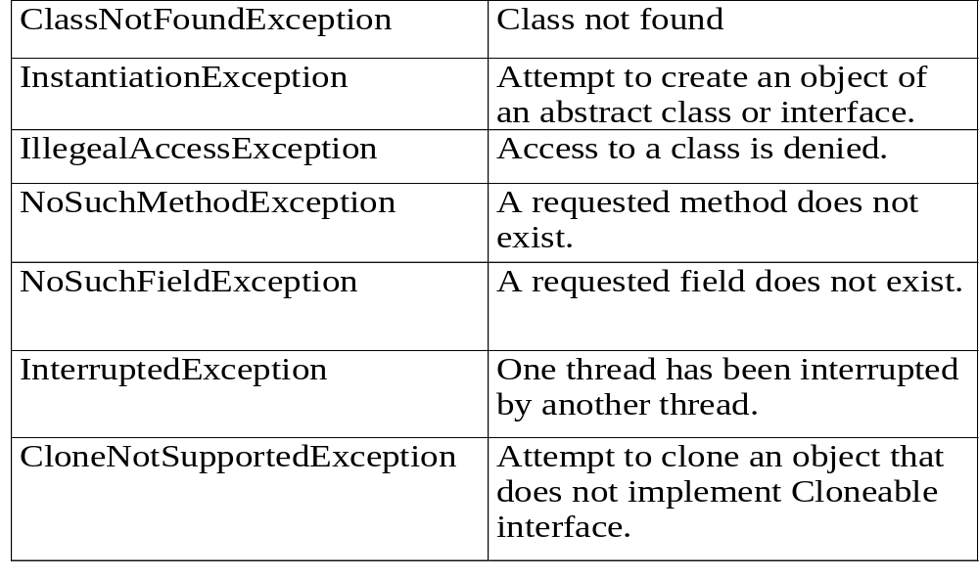
Checked Exceptions
Notes:
Checked exceptions represent useful information about the operation of a legally specified request that the caller may have had no control over and that the caller needs to be informed about--for example, the file system is now full, or the remote end has closed the connection, or the access privileges don't allow this action.

Slide 134
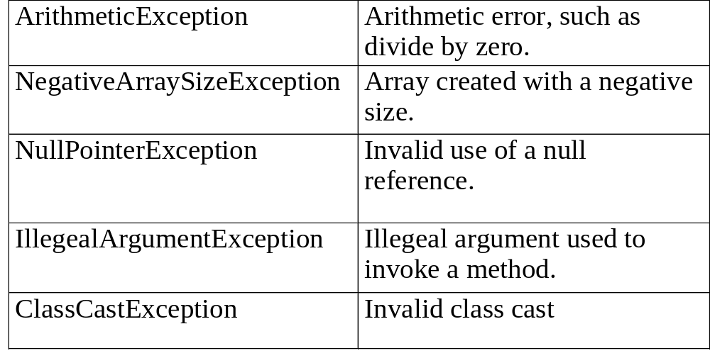
Unchecked Exceptions
Notes:
Runtime exceptions can occur anywhere in a program and in a typical program can be very numerous. The cost of checking for runtime exceptions often exceeds the benefit of catching or specifying them. Thus the compiler does not require that you catch or specify runtime exceptions, although you can. Checked exceptions are exceptions that are not runtime exceptions and are checked by the compiler; the compiler checks that these exceptions are caught or specified.

Slide 135
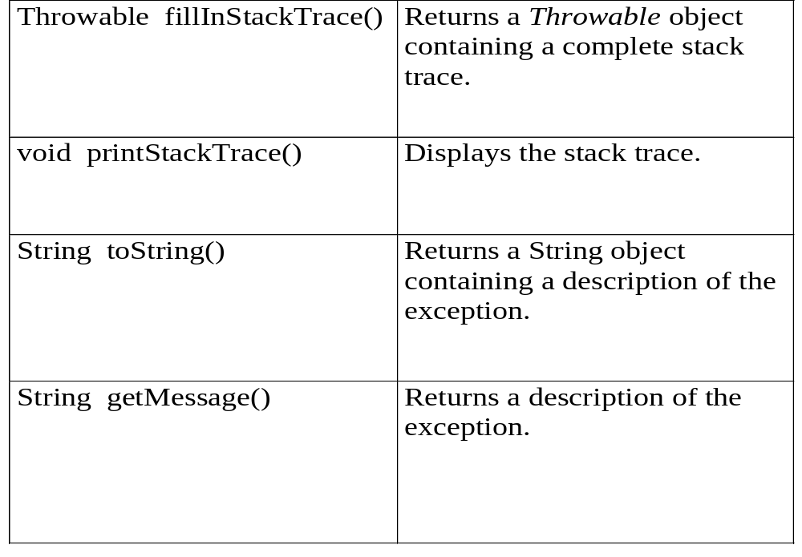
The Throwable Class
Notes:
By convention, class Throwable and its subclasses have two constructors, one that takes no arguments and one that takes a String argument that can be used to produce an error message.
A Throwable class contains a snapshot of the execution stack of its thread at the time it was created. It can also contain a message string that gives more information about the error.
fillInStackTrace()
Fills in the execution stack trace. This method records within this Throwable object information about the current state of the stack frames for the current thread. This method is useful when an application is re-throwing an error or exception.
getMessage()
Returns the error message string of this Throwable object.

Slide 136
Exception Handling
public class Demo {
public static void main(String [] args) {
int i = 0;
String greetings [] = { “Hello”,”Hi”,”Bye” };
while ( i <= greetings.length ) {
System.out.println(greetings[i]);
i++;
}
}
}
Notes:
Note that the continuation condition, "i <= greetings.length", implies that the last value of i that is actually processed is greetings.length-1, which is the index of the final item in the array. It's important to use "<" here, not "<=", since "<=" would give an array out of bounds error.

Slide 137
Exception Handling
try
  - use the try statement with the code that might throw an exception.
catch
  - use the catch statement to specify the exception to catch and the code to execute if the specified exception is thrown.
finally
  - used to define a block of code that we always want to execute, regardless of whether an exception was caught or not.
Notes:
try, catch and finally are three components of exception handler
try
The first step in writing an exception handler is to enclose the statements that might throw an exception within a try block. The try block is said to govern the statements enclosed within it and defines the scope of any exception handlers (established by subsequent catch blocks) associated with it.
catch
Next, you associate exception handlers with a try block by providing one or more catch blocks directly after the try block.
There can be no intervening code between the end of the try statement and the beginning of the first catch statement.
The catch block contains a series of legal Java statements. These statements are executed if and when the exception handler is invoked. The runtime system invokes the exception handler when the handler is the first one in the call stack whose type matches that of the exception thrown.
finally
The final step in setting up an exception handler is providing a mechanism for cleaning up the state of the method before (possibly) allowing control to be passed to a different part of the program. You do this by enclosing the cleanup code within a finally block.

Slide 138
Exception Handling
throw
  - typically used for throwing user-defined exceptions.
throws
  - lists the types of exceptions a method can throw, so that the callers of the method can guard themselves against the exception.
Notes:
All Java methods use the throw statement to throw an exception. The throw statement requires a single argument: a throwable object. In the Java system, throwable objects are instances of any subclass of the Throwable
As you know, the Java language requires that methods either catch or specify all checked exceptions that can be thrown within the scope of that method. You do this with the throws clause of the method declaration.

Slide 139
try and catch
public class Demo {
public static void main(String [] args) {
int x,y;
try {
x = 0;
y = 10/x;
System.out.println(“Now What ???”);
}
catch(ArithmeticException e) {
System.out.println(“Division by zero”);
}
System.out.println(“Hi I am back !!!”);
}
}
Notes:
ArithmeticException
Thrown when an exceptional arithmetic condition has occurred. For example, an integer "divide by zero" throws an instance of this class.
In the example shown in the slide x=0
When 10 is divided by 0, this exception is thrown.
It is caught in ArithmeticException and the statement in catch block is executed.
Even if no try and catch block is provided then also JVM throws an exception
for divide by 0

Slide 140
Notes:
Multiple catch Clauses
The Java language allows you to write general exception handlers that handle multiple types of exceptions.
Each catch clause catches a particular type of exception
public class Demo{
public static void main(String [] args){
try{
int a = args.length;
System.out.println(“a = “ + a);
int b = 10/a;
int c [] = { 1 };
c [10] = 100;
}
catch(ArithmeticException e){
System.out.println(“Divide by zero”);
}
catch(ArrayIndexOutOfBoundsException e){
System.out.println(“Index out of bounds”);
}
}
}

Slide 141
Nested try
public class Demo { catch(ArithmeticException e){
public static void main(String [] args){ System.out.println(“Div by 0”);
try{ }//outer catch
int a = args.length;
}//main
int b = 10/a;
try{ }//Demo
if ( a == 1)
a = a/(a-a);
if ( a == 2 ) {
int c [] = { 1 };
c[10] = 100;
}//if
}//inner try
catch( ArrayIndexOutOfBoundsException e){
System.out.println(“Out of Bounds”);
}//inner catch
}//outer try
Notes:
try statements can be nested to form a layered approach to handling exceptions.
When an exception occurs in a nested try block, a matching handler is sought following the nested try block. If a matching catch is not found, then a search occurs following the next layer try block. This continues until a match occurs, or until all catch statements have been viewed. If no match occurs, then the default handler is used.
Note that the nesting of try blocks may not be clearly seen. For example, a method may be called from within a try block. Inside the called method, another try block exists, thus nesting the new block inside the existing one.

Slide 142
The throws Clause
public class Demo {
public static void main(String [] args) {
try { fun1(); }
catch(Exception e) {
System.out.println(“In Main”);}
fun2();
}//main
public static fun1() throws Exception {
try{
System.out.println(“Try of fun1”);
throw new Exception(); }
catch(Exception e) {
System.out.println(Catch of fun 1”);}
finally{
System.out.println(“Finally of fun 1”);
}
}// fun 1
public static fun 2() {
System.out.println(“Hello”);
}// fun 2
}// Demo
Notes:
When a throw statement executes, all subsequent statements in the try block are skipped and the catch statements are evaluated in order to find a suitable handler.
The throws keyword is used to denote the fact that certain exceptions may not be handled by the current method.
The throws lists the types of exceptions that may be thrown inside a method for which no catch statement can be found inside the same class.
If the throws keyword is missing, then a compiler error will result.

Slide 143
Summary
In this session, you learnt to:
Distinguish between Error and Exception
Distinguish between checked and unchecked exceptions
Use try, catch and finally blocks
Use throw and throws keywords.
Describe the flow of control with/without exceptions and with/without appropriate handlers

Slide 144
CHAPTER 8
I/O and Inner Classes

Slide 145
Objective
At the end of this session, you will learn to:
Distinguish between byte-oriented and character-oriented streams
Describe the API for I/O
Describe the serialization mechanism
Use the inner classes and state its importance

Slide 146
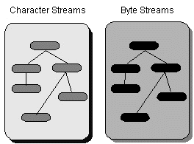
Streams
Notes:
Java I/O is defined in terms of streams. Streams are ordered sequences of data that have:
A source (input streams) or
A destination (output stream)
Streams are also classified in to two categories
1) Character streams
2) Byte streams
InputStream and OutputStream streams are of the type Byte streams.
Reader and Writer streams are of the type Character streams.
All the classes required to handle input and output are given in java.io package.

Slide 147
Notes:
Stream Types
Each type of stream results in four actual streams:
Byte based input (InputStream)
Byte based output (OutputStream)
Character based input (Reader)
Character based output (Writer)
To read and write 8-bit bytes, programs should use the byte streams, descendants of InputStream and OutputStream. InputStream and OutputStream provide the API and partial implementation for input streams (streams that read 8-bit bytes) and output streams (streams that write 8-bit bytes). These streams are typically used to read and write binary data such as images and sounds. Two of the byte stream classes, ObjectInputStream and ObjectOutputStream, are used for object serialization
Reader and Writer are the abstract superclasses for character streams in java.io. Reader provides the API and partial implementation for readers--streams that read 16-bit characters--and Writer provides the API and partial implementation for writers--streams that write 16-bit characters.
Piped Streams
Useful in communications between threads
Byte Array Streams
Read/write byte arrays
Filter Streams
Abstract classes, filter bytes from another stream. Can be chained together
Buffered Streams
Adds buffering
File Streams
Used for file I/O
Data Streams
Reads/writes built-in types (int, float, etc. )
Stream stores types in binary not ASCII or Unicode

Slide 148
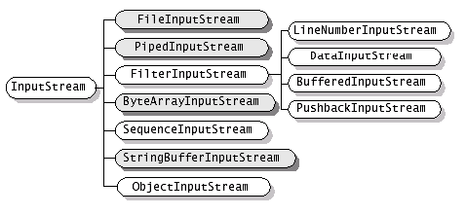
Byte Streams
Notes:
InputStream
This abstract class is the superclass of all classes representing an input stream of bytes. An input stream accepts input bytes from some sink or some stream.
Applications that need to define a subclass of InputStream must always provide a method that returns the next byte of input.
FileInputStream
A FileInputStream obtains input bytes from a file in a file system. What files are available depends on the host environment. FileInputStream is meant for reading streams of raw bytes such as image data. For reading streams of characters, consider using FileReader.
PipedInputStream
A piped input stream should be connected to a piped output stream; the piped input stream then provides whatever data bytes are written to the piped output stream. Typically, data is read from a PipedInputStream object by one thread and data is written to the corresponding PipedOutputStream by some other thread.

Slide 149
Notes:
FilterInputStream
A FilterInputStream contains some other input stream, which it uses as its basic source of data, possibly transforming the data along the way or providing additional functionality. The class FilterInputStream itself simply overrides all methods of InputStream with versions that pass all requests to the contained input stream. Subclasses of FilterInputStream may further override some of these methods and may also provide additional methods and fields.
LineNumberInputStream
This class is an input stream filter that provides the added functionality of keeping track of the current line number.
DataInputStream
A data input stream lets an application read primitive Java data types from an underlying input stream in a machine-independent way. An application uses a data output stream to write data that can later be read by a data input stream.
BufferedInputStream
A BufferedInputStream adds functionality to another input stream-namely, the ability to buffer the input When the BufferedInputStream is created, an internal buffer array is created. As bytes from the stream are read or skipped, the internal buffer is refilled as necessary from the contained input stream, many bytes at a time.
PushbackInputStream
A PushbackInputStream adds functionality to another input stream, namely the ability to "push back" or "unread" one byte. This is useful in situations where it is convenient for a fragment of code to read an indefinite number of data bytes that are delimited by a particular byte value; after reading the terminating byte, the code fragment can "unread" it, so that the next read operation on the input stream will reread the byte that was pushed back. For example, bytes representing the characters constituting an identifier might be terminated by a byte representing an operator character; a method whose job is to read just an identifier can read until it sees the operator and then push the operator back to be re-read.

Slide 150
Notes:
ByteArrayInputStream
A ByteArrayInputStream contains an internal buffer that contains bytes that may be read from the stream. An internal counter keeps track of the next byte to be supplied by the read method.
Closing a ByteArrayInputStream has no effect. The methods in this class can be called after the stream has been closed without generating an IOException.
SequenceInputStream
A SequenceInputStream represents the logical concatenation of other input streams. It starts out with an ordered collection of input streams and reads from the first one until end of file is reached, whereupon it reads from the second one, and so on, until end of file is reached on the last of the contained input streams.
StringBufferInputStream
This class allows an application to create an input stream in which the bytes read are supplied by the contents of a string.
ObjectInputStream
An ObjectInputStream deserializes primitive data and objects previously written using an ObjectOutputStream.

Slide 151
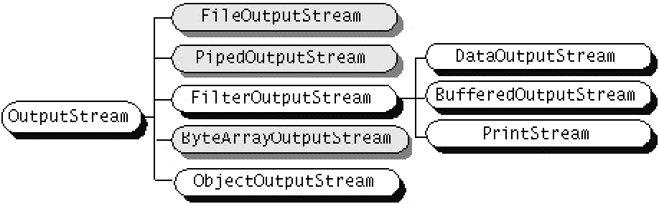
Byte Streams
Notes:
OutputStream
This abstract class is the superclass of all classes representing an output stream of bytes. An output stream accepts output bytes and sends them to some sink.
Applications that need to define a subclass of OutputStream must always provide at least a method that writes one byte of output.
BufferedOutputStream
The class implements a buffered output stream. By setting up such an output stream, an application can write bytes to the underlying output stream without necessarily causing a call to the underlying system for each byte written. The data is written into an internal buffer, and then written to the underlying stream. If the buffer reaches its capacity, the buffer output stream is closed, or the buffer output stream is explicitly flushed.
FilterOutputStream
This class is the superclass of all classes that filter output streams. These streams sit on top of an already existing output stream (the underlying output stream) which it uses as its basic sink of data, but possibly transforming the data along the way or providing additional functionality.

Slide 152
Notes:
ByteArrayOutputStream-
This class implements an output stream in which the data is written into a byte array. The buffer automatically grows as data is written to it. The data can be retrieved using toByteArray() and toString().
ObjectOutputStream-
An ObjectOutputStream writes primitive data types and graphs of Java objects to an OutputStream. The objects can be read (reconstituted) using an ObjectInputStream. Persistent storage of objects can be accomplished by using a file for the stream. If the stream is a network socket stream, the objects can be reconsituted on another host or in another process.
FileOutputStream-
A file output stream is an output stream for writing data to a File or to a FileDescriptor. What files are available or may be created depends on the host environment.
PipedOutputStream-
A piped output stream can be connected to a piped input stream to create a communications pipe. The piped output stream is the sending end of the pipe. Typically, data is written to a PipedOutputStream object by one thread and data is read from the connected PipedInputStream by some other thread. Attempting to use both objects from a single thread is not recommended as it may deadlock the thread.

Slide 153
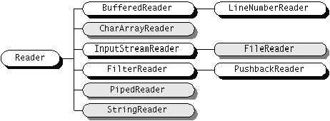
Character Streams
Notes:
Character based streams
The primary advantage of character streams is that they make it easy to write programs that are not dependent upon a specific character encoding, and are therefore easy to internationalize.
Java stores strings in Unicode, an international standard character encoding that is capable of representing most of the world's written languages. Typical user-readable text files, however, use encodings that are not necessarily related to Unicode, or even to ASCII, and there are many such encodings. Character streams hide the complexity of dealing with these encodings by providing two classes that serve as bridges between byte streams and character streams.
A second advantage of character streams is that they are potentially much more efficient than byte streams.
Reader-
Abstract class for reading character streams. The only methods that a subclass must implement are read(char[], int, int) and close(). Most subclasses, however, will override some of the methods defined here in order to provide higher efficiency, additional functionality, or both.

Slide 154
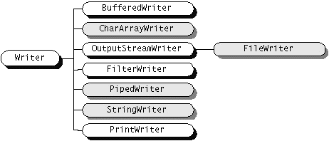
Character Streams
Notes:
Writer
Abstract class for writing to character streams. The only methods that a subclass must implement are write(char[], int, int), flush(), and close(). Most subclasses, however, will override some of the methods defined here in order to provide higher efficiency, additional functionality, or both.
BufferedWriter
Write text to a character-output stream, buffering characters so as to provide for the efficient writing of single characters, arrays, and strings.
CharArrayWriter
This class implements a character buffer that can be used as a Writer. The buffer automatically grows when data is written to the stream. The data can be retrieved using toCharArray() and toString().
OutputStreamWriter
Write characters to an output stream, translating characters into bytes according to a specified character encoding. Each OutputStreamWriter incorporates its own CharToByteConverter, and is thus a bridge from character streams to byte streams.
FilterWriter
Abstract class for writing filtered character streams.

Slide 155
Notes:
PipedWriter
Piped character-output streams.
StringWriter
A character stream that collects its output in a StringBuffer, which can then be used to construct a String.
PrintWriter
Print formatted representations of objects to a text-output stream. This class implements all of the print methods found in PrintStream. It does not contain methods for writing raw bytes, for which a program should use unencoded byte streams
FileWriter
Convenience class for writing character files. The constructors of this class assume that the default character encoding and the default byte-buffer size are acceptable.

Slide 156
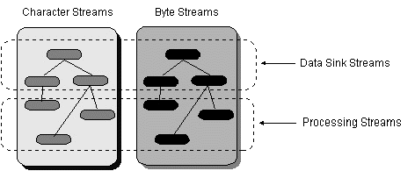
Streams
Notes:
Data sink streams read from or write to specialized data sinks such as strings, files, or pipes.
Processing streams perform some sort of operation, such as buffering or character encoding, as they read and write.

Slide 157
Notes:
Reading From an Input Stream
public abstract class InputStream extends Object
This abstract class is the superclass of all classes representing an input stream of bytes.
Applications that need to define a subclass of InputStream must always provide a method that returns the next byte of input.
public abstract int read( ) throws IOException
Reads the next byte of data from the input stream. The value byte is returned as an int in the range 0 to 255. If the end of the stream has been reached, the value -1 is returned. This method blocks until input data is available.
Returns:
the next byte of data, or -1 if the end of the stream is reached.
Throws:
IOException - if an I/O error occurs.
public int read(byte[] b) throws IOException
Reads some number of bytes from the input stream and stores them into the buffer array b. The number of bytes actually read is returned as an integer. This method blocks until input data is available.
If b is null, a NullPointerException is thrown. If the length of b is zero, then no bytes are read and 0 is returned. If no byte is available because the stream is at end of file, the value -1 is returned.
Parameters:
b - the buffer into which the data is read.
Returns:
the total number of bytes read into the buffer, or -1 if there is no more data because the end of the stream has been reached.
Throws: IOException - if an I/O error occurs.

Slide 158
Notes:
Reading From an Input Stream
public int read(byte[] b, int off, int len) throws IOException
Reads up to len bytes of data from the input stream into an array of bytes. The number of bytes actually read is returned as an integer.
Parameters:
b - the buffer into which the data is read.
off - the start offset in array b at which the data is written.
len - the maximum number of bytes to read.
Returns: the total number of bytes read into the buffer, or -1 if there is no more data because the end of the stream has been reached.
Throws: IOException - if an I/O error occurs.
long skip(long n) : Skips over and discards n bytes of data from this input stream.
int available() : Returns the number of bytes that can be read (or skipped over) from this input stream without blocking by the next caller of a method for this input stream.
void close() : Closes this input stream and releases any system resources associated with the stream.

Slide 159
Notes:
Reading From an Input Stream
public abstract class Reader extends Object
Abstract class for reading character streams. The only methods that a subclass must implement are read(char[], int, int) and close().
The Reader class provides a similar set of methods but they can read in unit of characters and array of characters.
int read()
int read(char cbuf[])
int read(char cbuf[], int offset, int length)
Bytes can be read one at a time or many at once :
InputStream is;
byte b;
while ( b = (byte) is.read() ) != -1 ) {
// Process
}
InputStream is;
int length;
byte [] b = new byte[512];
int bytesRead = is.read(b);

Slide 160
Notes:
Reading a File
import java.io.*;
public class FileViewer {
public FileViewer(String name) throws IOException {
int bytes_read = 0;
File f = new File(name);
int size = (int) f.length();
FileInputStream fis = new FileInputStream(f);
byte [] data = new byte[size];
while(bytes_read < size) {
bytes_read += fis.read(data, bytes_read, size-bytes_read);
System.out.println(new String (data) );
}
}
public static void main(String [] args) throws IOException {
if(args.length != 1) {
System.out.println(“USAGE:java FileViewer <filename>”);
System.exit(0);
}
new FileViewer(args[0] ); }
}

Slide 161
Notes:
Writing to an Output Stream
public abstract class OutputStream extends Object
This abstract class is the superclass of all classes representing an output stream of bytes. An output stream accepts output bytes and sends them to some sink.
Applications that need to define a subclass of OutputStream must always provide at least one method that writes one byte of output.
public abstract void write(int b) throws IOException
public void write(byte[] b) throws IOException
public void write(byte[] b, int off, int len)
throws IOException
public abstract class Writer extends Object
Abstract class for writing to character streams. The only methods that a subclass must implement are write(char[], int, int), flush(), and close().
Writer defines these methods for writing characters and arrays of characters
void write(int c)
void write(char cbuf[])
void write(char cbuf[], int offset, int length)

Slide 162
Using FileReader and FileWriter
import java.io.*;
public class Copy {
public static void main(String[] args) throws IOException {
File inputFile = new File(”Source.txt");
File outputFile = new File(”Target.txt");
FileReader in = new FileReader(inputFile);
FileWriter out = new FileWriter(outputFile);
int c;
while ((c = in.read()) != -1)
out.write(c);
in.close();
out.close();
}
}
Notes:
Convenience class for writing character files. The constructors of this class assume that the default character encoding and the default byte-buffer size are acceptable
Abstract class for reading filtered character streams.
public int read()
throws IOException
Read a single character.
public int read(char[] cbuf,
int off,
int len)
throws IOException
Read characters into a portion of an array.
public void write(int c)
throws IOException
Write a single character.

Slide 163
File Concatenation
import java.io.*;
public class Concatenate {
public static void main(String[] args) throws IOException {
ListOfFiles mylist = new ListOfFiles(args);
SequenceInputStream s = new SequenceInputStream(mylist);
int c;
while ((c = s.read()) != -1)
System.out.write(c);
s.close();
}
}

Slide 164
File Concatenation
import java.util.*;
import java.io.*;
public class ListOfFiles implements Enumeration {
private String[] listOfFiles;
private int current = 0;
public ListOfFiles(String[] listOfFiles) {
this.listOfFiles = listOfFiles;
}
public boolean hasMoreElements() {
if (current < listOfFiles.length)
return true;
else
return false;
}

Slide 165
File Concatenation
public Object nextElement() {
InputStream in = null;
if (!hasMoreElements())
throw new NoSuchElementException("No more files.");
else {
String nextElement = listOfFiles[current];
current++;
try {
in = new FileInputStream(nextElement);
} catch (FileNotFoundException e) {
System.err.println("ListOfFiles: Can't open " + nextElement);
}
}
return in;
}
}

Slide 166
Serializing Objects
How to Write to an ObjectOutputStream
  Writing objects to a stream is a straight-forward process. For example, the following gets the current time in milliseconds by constructing a Date object and then serializes that object:
FileOutputStream out= new FileOutputStream("theTime");
ObjectOutputStream s = new ObjectOutputStream(out);
s.writeObject("Today");
s.writeObject(new Date());
s.flush();
Notes:
Two streams in java.io-- ObjectInputStream and ObjectOutputStream-- are run-of-the-mill byte streams and work like the other input and output streams. However, they are special in that they can read and write objects.
The key to writing an object is to represent its state in a serialized form sufficient to reconstruct the object as it is read. Thus reading and writing objects is a process called object serialization. Object serialization is essential to building all but the most transient applications.
ObjectOutputStream must be constructed on another stream. This code constructs an ObjectOutputStream on a FileOutputStream, thereby serializing the object to a file named theTime.
Next, the string Today and a Date object are written to the stream with the writeObject method of ObjectOutputStream.
Thus, the writeObject method serializes the specified object, traverses its references to other objects recursively, and writes them all. In this way, relationships between objects are maintained.
ObjectOutputStream implements the DataOutput interface that defines many methods for writing primitive data types, such as writeInt, writeFloat, or writeUTF. You can use these methods to write primitive data types to an ObjectOutputStream.
The writeObject method throws a NotSerializableException if it's given an object that is not serializable. An object is serializable only if its class implements the Serializable interface.

Slide 167
Serializing Objects
How to Read from an ObjectInputStream
  Once you've written objects and primitive data types to a stream, you'll likely want to read them out again and reconstruct the objects.
  FileInputStream in = new FileInputStream("theTime");
  ObjectInputStream s = new ObjectInputStream(in);
  String today = (String)s.readObject();
  Date date = (Date)s.readObject();
Notes:
Like ObjectOutputStream, ObjectInputStream must be constructed on another stream. In this example, the objects were archived in a file, so the code constructs an ObjectInputStream on a FileInputStream. Next, the code uses ObjectInputStream's readObject method to read the String and the Date objects from the file. The objects must be read from the stream in the same order in which they were written. Note that the return value from readObject is an object that is cast to and assigned to a specific type.
The readObject method deserializes the next object in the stream and traverses its references to other objects recursively to deserialize all objects that are reachable from it. In this way, it maintains the relationships between the objects.
ObjectInputStream stream implements the DataInput interface that defines methods for reading primitive data types. The methods in DataInput parallel those defined in DataOutput for writing primitive data types. They include methods such as readInt, readFloat, and readUTF. Use these methods to read
primitive data types from an ObjectInputStream.

Slide 168
Notes:
import java.io.*;
public class SerializationDemo {
public static void main(String args[]) {
//Object Serialization
try {
MyClass object1 = new MyClass(“Hello”, -7, 2.7e10);
System.out.println(“object1; “ + object1);
FileOutputStream fos = new FileOutputStream(“serial”);
ObjectOutputStream oos = new ObjectOutputStream(fos);
oos.writeObject(Object1);
oos.flush();
oos.close();
}
catch(Exception e) {
System.out.println(“Exception during serialization: “ + e);
System.exit(0);
}
// Object Deserialization
try {
MyClass object2;
FileInputStream fis = new FileInputStream(“serial”);
ObjectInputStream ois = new ObjectInputStream(fis);
object2 = (MyClass)ois.readObject();
ois.close();
System.out.println(“object2: “ + object2);
}
catch(Exception e) {
System.out.println(“Exception during deserialization: “ + e);
System.exit(0);
}
}
}

Slide 169
Notes:
class Myclass implements Serializable {
String s;
int I;
double d;
public MyClass(String s, int I, double d) {
this.s = s;
this.I = I;
this.d = d;
}
public String toString() {
return “s=“ + s + “; I=“ + I + “; d=“ + d;
}
}

Slide 170
Object Serialization File Format
Following is the file format for Object Serialization Process :
  Every file begins with a 2 byte “magic number”.
  This is followed by the version number of the object serialization format.
  Followed by a sequence of objects, in the order that they were saved.
  When the object gets serialized, the class of the object is saved as well.
Notes:
Object serialization saves object data in a particular file format
File format is extremely important for gaining insight in to the object streaming process.
Every file begins with magic number
This is followed by the version number of the object serialization format
After this it contains a sequence of objects in the order they were saved
When the object is saved class of the object must be saved as well
The class description contains
The name of the class
The serial version unique ID, which is finger print of the data field types and
method signatures
A set flag describing the serialization method
A description of the data fields

Slide 171
Obtaining The Fingerprint
Java Runtime Environment gets the fingerprint by :
  Ordering descriptions of the class, superclass, interfaces, field types and method signatures.
  Applying the Secure Hash Algorithm to that data.
  The fingerprint is obtained by applying SHA on the class description.
The fingerprint is a 20 byte data packet, created by a sequence of bit operations on the data that makes it certain that the fingerprint will change if the information is altered in any way.
Notes:
Java gets finger print by
First ordering descriptions of the class, super class, interfaces, field types
and method signatures in a canonical way
After this the so called Secure Hash Algorithm(SHA) to that data
SHA is very fast algorithm that gives finger print to a larger block of information
The finger print is always a 20-byte data packet regardless the size of the original data
It is created by clever sequence of bit operations on the data
If the information is changed in any way finger print will change
SHA is the US standard recommended by the national Institute for Science and Technology

Slide 172
Notes:
Version Conflicts
As applications come up with new versions, object files must cope with the evolution of classes.
But when a class definition changes the SHA fingerprint also changes and object streams refuse to read object objects with different fingerprints.
However a class can indicate that it compatible with it’s earlier version :
First it must obtain the fingerprint of the earlier version of the class.
Then all later versions of the class must define the serialVersionUID constant to the same fingerprint as the original.
In situations where only the property of the objects change this technique is sufficient.
In cases where we have changes in the data fields of objets, the object stream matches the data fields of the current version of the class with the data fields of the version in the stream :
if two fields have matching names but different types, then the stream makes no effort to convert one type to another. (incompatible)
If the object in the stream has fields that are not present in the current version then the objevt stream ignores the additional data.
If the current version has data fields that are not present in the streamed object, the added fields are set to their default.

Slide 173
Inner Classes
Notes:
Inner Classes
Java provides two kinds of inner class static and non-static.
By default inner classes are non-static.
A non-static inner class can be instantiated only within a non static method of the outer class.
This is because every instance of a non-static inner class exists inside an instance of the outer class.
The inner class methods can access directly any of the members of the outer class.
public class A {
int x;
public class B {
int y;
void foo(){}
}
}
Inner classes have access to this reference.
Inside foo this will refer to an instance of B.
To access the outer class instance inside foo we can use A.this.
public class Outer {
private int x;
public class Inner {
private int y;
public void innerMethod() {
System.out.println(“y is : “ + y);
}
}
public void outerMethod() {
System.out.println(“x is : “ + x);
}
}

Slide 174
Notes:
Constructing Inner Classes
When a instance of an inner class is created, there must normally be a pre-existing instance of the outer class acting as context. e.g.
Outer.Inner io = new Outer().new Inner();
io.innerMethod();
or
Outer o = new Outer();
Outer.Inner io = o.new Inner();
io.innerMethod();
Static Inner Classes
A static inner class does not have any reference to an enclosing instance.
Methods of a static inner class can not access instance variables of the enclosing class, however they can access static members of the enclosing class.
You can create a instance of a static inner class without the need for a current instance of the enclosing class.
Ex:
class A {
int x;
static int y;
static class B {
int z;
void foo() {
System.out.println(x); //illegal System.out.println(y);
System.out.println(z);
}
}
}
In order to instantiate the class B we can write ;
A.B obj = new A.B();
Now using this instance we can access the inner class methods in the normal way :
obj.foo();

Slide 175
Notes:
Classes Defined Inside Methods
public class Oute
{
public static void main(String [] args) {
Outer o = new Outer();
o.compute(100,200);
}//main()
public void compute(int x, final int y) {
int a = (x + y);
final int b = (x - y);
class Inner {
public void method() {
System.out.println(“ X is “ + x); //illegal
System.out.println(“ Y is “ + y);
System.out.println(“ a is “ + a); //illegal
System.out.println(“ b is “ + b);
}//method()
}//Inner
Inner in = new Inner();
in.method();
}//compute
}//Outer

Slide 176
Notes:
Anonymous Classes
Classes defined inside a method, having no name.
Anonymous classes are defined in the place they are constructed.
public void method() {
theButton.addActionListener(
new ActionListener() {
public void actionPerformed(ActionEvent e) {
System.out.println(“Hello”);
}
}
);
}
The class is instantiated and declared at the same place.
The declaration and the instantiation take the form
new Xxx() { // body }
where Xxx is the interface name.
An anonymous class can not have a constructor.
An anonymous class can be a subclass of another explicit class, or it can implement a single interface. It can not be both an explicit subclass and implement an interface.
If an anonymous class extends an existing class, then arguments for the superclass constructor may be placed in the argument part of the new expression.
new Button(“OK”) { // body }

Slide 177
Summary
In this session, you learnt to:
Distinguish between byte oriented and character oriented streams
Describe the API for I/O
Describe the serialization mechanism
Use the inner classes and state its importance

Slide 178
CHAPTER 9
Swing

Slide 179
Objective
At the end of this session, you will be able to:
Distinguish between AWT and Swing
Describe the need for Swing
Describe the MVC Architecture
Describe the event handling mechanism
State the layout managers
Use the layout managers
Develop some GUI based java applications

Slide 180
Topics
Intro
  History
  JFC
What makes Swing so Hot?
  Lightweight Components
  PLAF
  MVC
  Delegation Event Model
How Do I Use Swing?
  Components
  JComponent
  Root Panes
  Layouts
WorkShop
Summary

Slide 181
Why Swing?
AWT is not functional enough for full scale applications
  the widget library is small
  the widgets only have basic functionality
  extensions commonly needed
AWT Components rely on native peers
  widgets won’t perform exactly the same on different platforms
Notes:
Java is a relatively new programming language that uses an object-oriented
approach that has become popular for developing Internet applications.
However Java had a weakness: it lacked the complex graphic user interface
(GUI) components needed to make large-scale windowing applications. Java did
have a GUI toolkit: the Abstract Window Toolkit (AWT), but it was not
functional enough for full-scale graphic applications. The widget library was
small and contained only the most basic of components. Those components only
had basic functionality (such as buttons that could only have text labels not
images). This meant that developers who wanted more had to spend
considerable time creating classes to extend the functionality of the widgets
provided by the AWT. In the fast-moving world of software development this
was a serious waste of resources. Also, the AWT components relied on native
peers which meant that portability was hampered by minor differences in the
way each operating system handled a particular widget, and the look-and-feel of
the components was governed by the native operating system (OS).

Slide 182
History
Project began late 1996
Active development since spring 1997
Beta in late 1997
Initial release march 1998 as part of the JFC
Notes:
In response to these and other problems Sun began a project to "beef up" Java in
1996. The result was the Java Foundation Classes released in 1998. Swing is
the new and improved GUI toolkit included in the JFC. With Swing, Java can
produce highly complex GUI's for full-scale windowing applications.

Slide 183
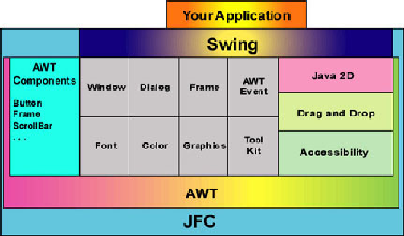
Java Foundation Classes
AWT
Swing
Accessibility
2D API
Drag and Drop
Notes:
The Java Foundation Classes are Sun's answer to Java's deficiencies. They were
released in March 1998 and contained five main elements: Java2d, accessibility,
Drag and Drop, AWT, and Swing.
Java2d has classes for more complex use of painting, shape, color, and fonts.
Accessibility is a set of tools for implementing support for physically challenged
users in an application that use non-traditional means for input and output.
Drag and Drop is an API which allows GUI objects to be "dragged" via the
mouse from one part of an application to another, between Java applications, or
even between Java and other applications.
The AWT is the original one from Java and is included to support code that
already uses the AWT.
In this session we primarily focus on Swing. Swing is designed for forms-based
applications development. It provides a rich set of components and a framework
to specify how to present GUIs that are visually independent of the platform.

Slide 184
Why is Swing so Hot?
It uses lightweight components
It uses a variant of the Model View Controller Architecture (MVC)
It has Pluggable Look And Feel (PLAF)
It uses the Delegation Event Model
Notes:
Swing has a number of new features to improve GUI design in applications.
These are lightweight components, a variant of the Model-View-Controller
Architecture (MVC), and Pluggable Look-and-Feel (PLAF). It also uses the
Delegation Event Model from JDK 1.1.

Slide 185
Heavyweight Components
Used by the AWT
Rectangular
Opaque
Rely on native peers
  Look and Feel tied to operating system
  functionality determined by operating system
  faster, because the OS handles the work
Notes:
One of the weaknesses of the AWT is it's use of heavyweight components. These are widgets which rely on native peers for their look-and-feel. These peer classes are linked to corresponding widgets and are responsible for talking to the native operating system. They tell that operating system to create the widget, so it has the same appearance as a native one. This is why an AWT button on a Windows platform looks different from the same button displayed on a Mac. This reliance on the native OS proves troublesome for a number of reasons. Since the developer has no direct control over the look of components changing the look of components is difficult. Also, Peer-driven widgets may behave differently depending on the platform. These differences are slight, but if they are a problem for the developer they may require complex code to fix. This is one of the reasons that the AWT components have only basic functionality. More complex abilities would be too difficult to implement cross-platform. Since native peers are required, a common, cross-platform look & feel is impossible. This makes it awkward for developers who want their software to run on other platforms as documentation and testing have to be done for each OS they want to use. This would not be such a problem except that one of Java’s strengths, that it is a cross-platform language.

Slide 186
Lightweight Components
Can have transparent portions
Can be of any shape
Can overlap each other
Mouse events fall through transparent portions
Do not rely on native peers
  Look and Feel drawn at runtime so can vary
  functionality is the same on all platforms
  slower because Java has to do the work

Slide 187
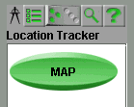

Lightweight Vs Heavyweight
Notes:
Another feature of lightweight components is that the developer can
control their appearance. The above image shows the difference in
appearance between Swing and AWT components. It also demonstrates
that Swing components can have transparent portions (the large
green button has a transparent border which allows it to appear to have
an oval shape). The effect of the transparency is such that Mouse
Events on the transparent portions will "fall through" to the underlying
component, thus all owing the component to act like it is not
rectangular

Slide 188
Model-View-Controller
Independent elements:
Model
  state data for each component
  different data for different models
View
  how the component looks onscreen
Controller
  dictates how the component reacts to events
Notes:
The appearance control available in lightweight components is a result of
a new kind of architecture used by Swing: the Separable Model architecture.
This is a variant of the Model-View-Controller (MVC) design. The structure
of MVC is that a component will have three separate elements: the Model,
the View, and the Controller. The Model is the element that manages the state
of the component. It holds the data for it and is the source for obtaining .
information about the component. The View is the visual representation of the
state of the component. This defines how it looks onscreen. The Controller
decides how the user can interact with the component. The image in next slide
shows how the three are related:

Slide 189
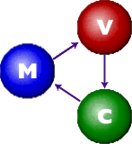
MVC Communication
Model passes data to view
for rendering
View determines which
events are passed to controller
Controller updates model
based on events received
Notes:
The Model passes its state data to the View for rendering, the View determines
which events are passed to the Controller, and the Controller updates model
based on the results of those events.

Slide 190

MVC Example
Model: Minimum=0
Maximum=100
Value=0
View:
Controller:
-accept mouse click on end buttons
-accept mouse drag on thumb
Notes:
The interaction with the model is hidden from the programmer inside the
component class so that queries sent to the component about it's Model data are
forwarded to that component's Model without explicit direction from the
programmer.
For example, the call:
slider.getValue()
where slider is a JSlider will access the getValue()
method in the JSlider class:
public int getValue() {
return getModel().getValue();
}
which returns the value stored in the JSlider's Model.

Slide 191
MVC in Java
Swing uses the model-delegate design, a similar architecture to MVC.
The View and Controller elements are combined into the UI delegate since Java handles most events in the AWT anyway.
Multiple views can be used with a single model.
Changes to a single Model can affect different views.

Slide 192


MVC in Java
Components can share a model
(JScrollbar and JSlider share the
BoundedRangeModel).

Slide 193
MVC in Java
Component
UI-delegate
View
Model
Controller
Notes:
Most components provide the model-defined API directly in the component
class. The component can be manipulated without interacting with the model at
all.
//example of method in JSlider class
public int getValue() {
return getModel().getValue();
}
//so we can use the following and avoid the model
JSlider slider = new JSlider();
int value = slider.getValue();

Slide 194
PLAF Features in Swing
Default Metal style
Can emulate Motif, and Windows styles
Supports Mac style through download
New styles can be designed
Can be reset at runtime
Notes:
Because of the Model-Delegate architecture, and it's separation of model and appearance, Swing is able to implement a new feature: Pluggable Look-and-Feel. This feature allows the entire component tree of an application to take on a new visual representation. The UI-delegate is changed so that the appearance changes even though the Model remains the same. It is called pluggable because the look-and-feel can be set at any time. This means that an application can change its look-and-feel during execution.
There are three look-and-feel options that are included in Swing. The default Metal Look-and-Feel (also known as Java Look-and-Feel) is used if no other style is set or if the specified style cannot be used due to an error. It can run in any environment. The Windows Look-and-Feel mimics the design of Windows widgets. It can be used only on Microsoft Windows platforms. Thirdly, the Motif Look-and-Feel (or CDE) has the same style as the OSF/Motif 1.2.5 Unix environment. It can be run on any platform. There is also a Macintosh Look-and-Feel currently available for download. In addition, a developers can create a new look-and-feel of their own.

Slide 195
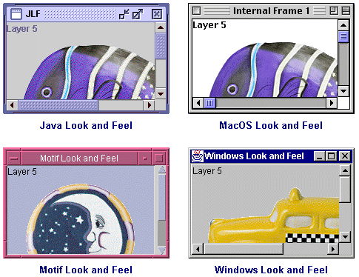
PLAF examples
Notes:
As mentioned before all components have an abstract UI delegate in the swing.plaf package. This delegate is named using the convention of removing the J-prefix and adding the suffix UI (JButton has UI delegate ButtonUI). This UI delegate is accessed by the get/setUI() methods.

Slide 196
PLAF Structure
All components have an abstract UI delegate in the swing.plaf package (JButton - ButtonUI)
UI delegate is accessed by get/setUI() method
Each Look and Feel has a concrete class for each abstract UI delegate (WindowsButtonUI)
communicate through UIManager class
  get/setLookAndFeel()
Notes:
Each look-and-feel has a concrete class for each of the abstract UI delegates. For example the Windows Look-and-Feel has a WindowsButtonUI class for the abstract ButtonUI. A static UIManager class handles the communication to set or get the look-and-feel through the get/setLookAndFeel() methods. Since the method to change the component tree takes as a parameter the widget to use as the root of the tree, look-and-feel changes can be made to only portions of the application instead of the entire application if the developer wishes.

Slide 197
Delegation Event Model
Swing relies on the Delegation Event Model of JDK 1.1.
In JDK 1.0 only component classes have event handling methods, and so no other objects can handle events.
Component event handling methods are replaced by event listener interfaces and adapter classes
Any class can use listener interfaces or adapter classes.
Notes:
Swing relies heavily on the new Event Model developed and released in JDK 1.1. Though this event Model precedes Swing, and is technically not part of Swing, it is an important foundation for Swing and deserves some discussion. This also allows a separation of the Model and Delegate so that the features of Swing are possible.

Slide 198
JDK 1.0 Event Model
programs must subclass GUI components and override action() or handleEvent()
many classes are needed
events are propagated up the GUI hierarchy until it is consumed or the root of the hierarchy is reached
events for a hierarchy can be handled by one container (complex conditional statement needed)
Notes:
The 1.0 Event Model was a chain model based on inheritance. Only component
classes could handle events. To do so a component had to override the action()
or handleEvent() methods to capture events. Once captured, an event could
either be consumed or propagated up the GUI hierarchy until it reached the root
or was consumed. Overriding methods meant the component had to be sub-
classed.

Slide 199
JDK 1.0 Event Model Problems
subclassing components without changing them is redundant and cumbersome
no separation of the application model from the GUI is possible (no MVC)
complicated to process different event types since events are handled by the same methods
events are delivered to components whether or not the components handle them
Notes:
This meant that many classes would have to be created to handle events. This
proved cumbersome. To lessen the number of classes one class could be used to
handle the events for its children. This reduced the number of classes needed, but
instead meant that complicated conditional statements were needed to process
events. Also, all components in the hierarchy would receive events whether or
not they actually used them. This meant a lot of overhead was spent moving
events around before they were dealt with.

Slide 200
JDK 1.1 Event Listeners
objects that implement a specific EventListener interface extended from the generic java.util.EventListener
define the methods which are to be invoked by the event source in response to each specific event type handled by the interface
Notes:
The 1.1 Event model is very different. It is called the Delegation Event Model.
In the new model there are three elements Events, Sources, and Listeners.
Events are of different types and each is a subclasses of java.awt.Event which
is itself a subclass of java.util.EventObject.
Events are fired by Sources. Sources are usually GUI components. They have a
list of Listeners attached to them with each Listener handling a specific type of
event. Since multiple Listeners can be added to a Source different events can be
handled by different objects. When an event occurs, the Source will notify all
interested Listeners by invoking the handling method in the Listener with the
Event as a parameter.

Slide 201
Event Types
Low level
  low-level input or window-system occurrence on a visual component on the screen
  java.awt.event.ComponentEvent (component resized, moved, etc.)
  java.awt.event.KeyEvent (component got key-press, key-release, etc.)
  java.awt.event.MouseEvent (component got mouse-down, mouse-move, etc.)
  java.awt.event.FocusEvent (component got focus, lost focus)
Notes:
There are two kinds of events: Low-level and Semantic. Low-level events are
triggered by interaction with visual components on the screen. They include
ComponentEvent (component is resized or moved), FocusEvent
(component gains or loses focus), MouseEvent (mouse-down, mouse-move)
and the like.

Slide 202
Event Types
Semantic
  related to the semantics of a user interface component's model
  java.awt.event.ActionEvent ("do command")
  java.awt.event.AdjustmentEvent ("component’s value adjusted")
  java.awt.event.ItemEvent ("item state has changed")
  java.awt.event.TextEvent ("the value of the text changed")
Notes:
Semantic events are triggered by interaction with a component's model. They
include ActionEvent ("do command"), AdjustmentEvent ("value
adjusted"), ItemEvent ("item state changed") and the like.

Slide 203
Event Sources
Multiple event listeners can be assigned to a source (order not guaranteed)
Low level
  java.awt.Component
    addComponentListener(ComponentListener l)
    addMouseListener(MouseListener l)
    addMouseMotionListener(MouseMotionListener l)
Semantic
  java.awt.List
    addActionListener(ActionListener l)
    addItemListener(ItemListener l)
Notes:
Listeners are objects that implement all the methods for handling events. If more than one method exists Adapter classes can be used instead. Adapters simply extend the appropriate Listener Interface so that only the important methods need to be overwritten. Listeners include ComponentListener, FocusListener, MouseListener, WindowListener, ActionListener, ItemListener, and more.
This new event model means that only interested components will hear about
events, and the events are filtered by type so no extra overhead is needed. Also,
no propagation through the GUI hierarchy is required so events are handled
cleaner and faster.

Slide 204
Adapters
Can be extended instead of using interfaces when the interface has many unused methods
Some adapter classes are
  java.awt.event.ComponentAdapter
  java.awt.event.ContainerAdapter
  java.awt.event.FocusAdapter
  java.awt.event.KeyAdapter
  java.awt.event.MouseAdapter
  java.awt.event.MouseMotionAdapter
  java.awt.event.WindowAdapter

Slide 205
New Swing Event Classes
Component Events Description
JPopupMenu PopupMenuEvent User selected a choice
JComponent AncestorEvent An event occurred in an ancestor
JList ListSelectionEvent User double-clicked a list
item
ListDataEvent List's contents were changed
JMenu MenuEvent User selected menu item
JTextComponent CaretEvent Mouse clicked in text
UndoableEditEvent An undoable edit has occurred
JTable TableModelEvent Items added/removed from table
TableColumnModelEvent A table column was moved
JTree TreeModelEvent Items added/removed from tree
TreeSelectionEvent User selected a tree node
TreeExpansionEvent User changed tree node
JWindow WindowEvent User manipulated window

Slide 206
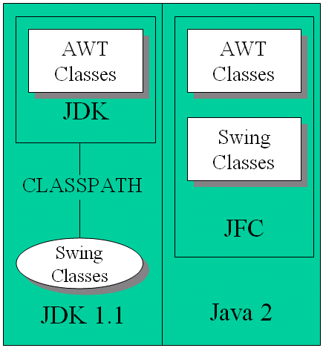
How do I Use Swing?
Notes:
If you are Using JDK 1.1, download swingall.jar and add it to the classpath
with Java 2 ver 1.2 and 1.3 it is already included.
For aplets use Java 1.1 or 1.2 enabled browser

Slide 207
Packages of Note
javax.accessibility
javax.swing
javax.border
javax.swing.event
javax.plaf
com.sun.java.swing.plaf
Notes:
javax.accessibility - for disabled-persons accessibility
javax.swing - new GUI tools
javax.border - classes for designing borders for components
javax.swing.event - event classes for the new model
javax.plaf - Look and Feel classes for Windows and Motif
com.sun.java.swing.plaf - classes for the default Metal Look and Feel

Slide 208
JComponent Class
the common root of most of the Swing GUI classes
provides the guiding framework for GUI objects
extends java.awt.Container class
  other objects can be added to it (be careful)
Notes:
The JComponent class extends the container class, which itself extends
Component. The Component class includes everything from providing
layout hints to supporting painting and events. The Container class has
support for adding components to the container and laying them out.
JComponent Features
Few of the functionality provided by JComponent class to its descendants
are:
Tool tips
By specifying a string with the setToolTipText method, you can
provide help to users of a component. When the cursor pauses over the
component, the specified string is displayed in a small window that
appears near the component.
Borders
The setBorder method allows you to specify the border that a
component displays around its edges.

Slide 209
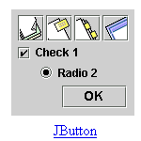
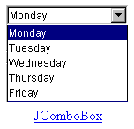
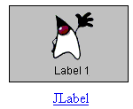
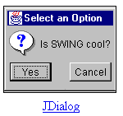
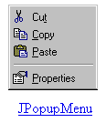
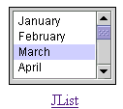
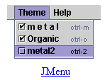
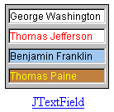
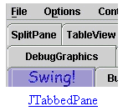
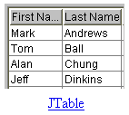
Useful Components
Notes:
Keyboard-generated actions
Using the registerKeyboardAction method, you can enable the
user to use the keyboard, instead of the mouse, to operate the GUI.The
combination of character and modifier keys that the user must press to
start an action is represented by a KeyStroke object. The resulting
action event must be handled by an ActionListener.
Application-wide pluggable look and feel
Behind the scenes, each JComponent object has a corresponding
ComponentUI object that performs all the drawing, event handling, size
determination, and so on for that JComponent. Exactly which
ComponentUI object is used depends on the current look and feel, which
you can set using the UIManager.setLookAndFeel method.
Properties
You can associate one or more properties (name/object pairs) with any
Jcomponent. For example, a layout manager might use properties
to associate a constraints object with each JComponent it manages. You
put and get properties using the putClientProperty and
getClientProperty methods.

Slide 210
Methods Inherited from Component Class
get/setBackground()
is/setEnabled()
get/setFont()
get/setForeground()
get/setLayout()
get/setLocationOnScreen()
get/setName()
get/setParent()
is/setVisible()

Slide 211
New Methods
get/setBounds()
get/setSize()
get/setLocation()
get/setWidth()
get/setHeight()
get/setMaximumSize()
get/setMinimumSize()
get/setPreferredSize()
Notes:
Methods to increase efficiency
JComponent has few methods that provide more efficient ways to get
information than the JDK 1.1 API allowed. The methods include getX
and getY, which you can use instead of getLocation; and getWidth and
getHeight, which you can use instead of getSize. It also adds one-
argument forms of getBounds, getLocation, and getSize for which you
specify the object to be modified and returned, letting you avoid
unnecessary object creation. These methods have been added to
Component for Java 2 (JDK 1.2).

Slide 212
New Methods
get/setBorder()
is/setDoubleBuffered()
getGraphics()
get/setToolTipText()
add()
remove()
pack()
Notes:
Methods to increase efficiency
JComponent has few methods that provide more efficient ways to get
information than the JDK 1.1 API allowed. The methods include getX
and getY, which you can use instead of getLocation; and getWidth and
getHeight, which you can use instead of getSize. It also adds one-
argument forms of getBounds, getLocation, and getSize for which you
specify the object to be modified and returned, letting you avoid
unnecessary object creation. These methods have been added to
Component for Java 2 (JDK 1.2).

Slide 213
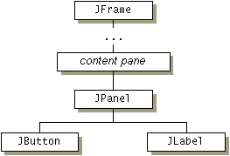
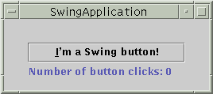
Swing Component and Containment Hierarchy
Notes:
Even the simplest Swing program like the one in slide will have multiple levels
in its containment hierarchy. The root of the containment hierarchy is always a
top-level container. The top-level container provides a place for its descendent
Swing components to paint themselves.
The frame is a top-level container. It exists mainly to provide a place for other
Swing components to paint themselves. The other commonly used top-level
containers are dialogs (JDialog) and applets (JApplet).
The panel is an intermediate container. Its only purpose is to simplify the
positioning of the button and label. Other intermediate Swing containers, such as
scroll panes (JScrollPane) and tabbed panes(JTabbedPane),typically
play a more visible, interactive role in a program's GUI.
The button and label are atomic components -- components that exist not to hold
random Swing components, but as self-sufficient entities that present bits of
information to the user. Often, atomic components also get input from the user.
The Swing API provides many atomic components, including combo boxes
(JComboBox), text fields (JTextField), and tables (JTable).

Slide 214
Adding components to containers
frame = new JFrame(...);
button = new JButton(...);
label = new JLabel(...);
pane = new JPanel();
pane.add(button);
pane.add(label);
frame.getContentPane().add(pane,BorderLayout.CENTR);

Slide 215
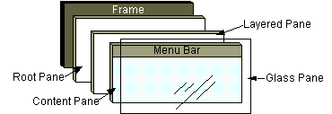
Root panes
Notes:
In general, we don't directly create a JRootPane object. Instead, we get a
JRootPane (whether we want it or not!) when we instantiate one of the
top-level Swing containers, such as JApplet, JDialog, and Jframe.
Root pane has four parts:
The glass pane
Hidden, by default. If you make the glass pane visible, then it's like a
sheet of glass over all the other parts of the root pane. It's completely
transparent unless you implement the glass pane's paint method so that
it does something, and it intercepts input events for the root pane.
The layered pane
Serves to position its contents, which consist of the content pane and the
optional menu bar. Can also hold other components in a specified Z order
The content pane
The container of the root pane's visible components, excluding the menu
bar.
The optional menu bar
The home for the root pane's container's menus. If the container has a
menu bar, you generally use the container's setJMenuBar method to
put the menu bar in the appropriate place.

Slide 216
Layout Managers
arrange widgets according to a pattern
can update containers to handle resizing of the container or internal widgets
make complex UIs possible
Notes:
Layout management is the process of determining the size and position of
components. By default, each container has a layout manager -- an object that
performs layout management for the components within the container.
Components can provide size and alignment hints to layout managers, but layout
managers have the final say on the size and position of those components.
Manager Description
java.awt.BorderLayout Arranges elements along the north, south, east,
west, and in the center of the container.
java.swing.BoxLayout Arranges elements in a single row or single
column.
java.awt.CardLayout Arranges elements like a stack of cards, with one visible at
a time.
java.awt.FlowLayout Arranges elements left to right across the container.
java.awt.GridBagLayout Arranges elements in a grid of variable sized
cells (complicated).
java.awt.GridLayout Arranges elements into a two-dimensional grid of equally
sized cells.
java.swing.OverlayLayout Arranges elements on top of each other.

Slide 217
Default Layout Managers
In AWT, the default layout for applets was FlowLayout.
Container Layout Manager
JApplet BorderLayout (on its content pane)
JBox BoxLayout
JDialog BorderLayout (on its content pane)
JFrame BorderLayout (on its content pane)
JPanel FlowLayout
JWindow BorderLayout (on its content pane)
Top-level windows use BorderLayout

Slide 218
Flow Layout
Arranges components from left to right and top to bottom
Fits as many components in a row as possible before making a new row
lets you specify alignment, horizontal and vertical spacing
1
2
3
4
5
Notes:
FlowLayout puts components in a row, sized at their preferred size. If the
horizontal space in the container is too small to put all the components in one
row, FlowLayout uses multiple rows. Within each row, components are
centered (the default), left-aligned, or right-aligned as specified when the
FlowLayout is created.
Example:
toolbar.setLayout(new FlowLayout(FlowLayout.LEFT));
toolbar.add(playButton);
toolbar.add(stopButton);

Slide 219
Border Layout
Arranges components according to specified edges or the middle
  NORTH
  SOUTH
  EAST
  WEST
  CENTER
C
N
W
E
S
contentPanel.setLayout(new BorderLayout(0, 0));
contentPanel.add("Center", oPanel);
contentPanel.add("South", controlPanel);
Notes:
A BorderLayout has five areas: north, south, east, west, and center. If you
enlarge the window, the center area gets as much of the available space as
possible. The areas expand only as much as necessary to fill all available space.
Often, a container uses only one or two of the areas of the BorderLayout --
just the center, or center and south.
for example:
Container contentPane = getContentPane();
//Use the content pane's default BorderLayout.
//contentPane.setLayout(new BorderLayout()); //unnecessary
contentPane.add(new JButton("Button 1 (NORTH)"),
BorderLayout.NORTH);
contentPane.add(new JButton("2 (CENTER)"), BorderLayout.CENTER);
contentPane.add(new JButton("Button 3 (WEST)"),
BorderLayout.WEST);
contentPane.add(new JButton("Long-Named Button 4 (SOUTH)"),
BorderLayout.SOUTH);
contentPane.add(new JButton("Button 5 (EAST)"),
BorderLayout.EAST);

Slide 220
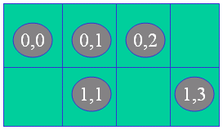
Grid Layout
Arranges components in a grid with specified rows and columns
rows have same height and columns have same width
contentPanel.setLayout(new GridLayout(2, 4));
contentPanel.add(startButton);
contentPanel.add(stopButton);
Notes:
A GridLayout places components in a grid of cells. Each component takes all
the available space within its cell, and each cell is exactly the same size. If you
resize the GridLayout window, you'll see that the GridLayout changes
the cell size so that the cells are as large as possible, given the space available
to the container.
Example:
Container contentPane = getContentPane()
contentPane.setLayout(new GridLayout(0,2));
contentPane.add(new JButton("Button 1"));
contentPane.add(new JButton("2"));
contentPane.add(new JButton("Button 3"));
ContentPane.add(new JButton("Long-Named Button 4"));
contentPane.add(new JButton("Button 5"));
The constructor tells the GridLayout class to create an instance that has
two columns and as many rows as necessary.

Slide 221
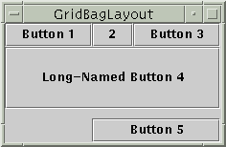
Gridbag Layout
Notes:
GridBagLayout is the most flexible -- and complex -- layout manager the
Java platform provides. A GridBagLayout places components in a grid of
rows and columns, allowing specified components to span multiple rows or
columns. Not all rows necessarily have the same height. Similarly, not all
columns necessarily have the same width. Essentially, GridBagLayout
places components in rectangles (cells) in a grid, and then uses the components'
preferred sizes to determine how big the cells should be.

Slide 222
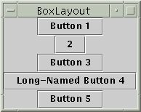
Box Layout
Notes:
The Swing packages include a general purpose layout manager named
BoxLayout. BoxLayout either stacks its components on top of each other
(with the first component at the top) or places them in a tight row from left to
right -- your choice. You might think of it as a full-featured version of
FlowLayout. Here is an applet that demonstrates using BoxLayout to
display a centered column of components:
By creating one or more lightweight containers that use BoxLayout, you can
achieve some layouts for which the more complex GridbagLayout is often
used. BoxLayout is also useful in some situations where you might consider
using BorderLayout or BorderLayout. One big difference between
BoxLayout and the existing AWT layout managers is that BoxLayout
respects each component's maximum size and X/Y alignment.

Slide 223
Workshop
Notes:
Work shop

Slide 224
Case Study: Designing a Basic GUI
Basic User Interface Tasks:
  Provide help/guidance to the user.
  Allow input of information.
  Allow output of information.
  Control interaction between the user and device.
Problem Description: Design a GUI for a Java application that converts miles to kilometers. Write the class that performs the conversions.
Notes:
Class to convert miles to kilometers:
public class MetricConverter {
public static double milesToKm(double miles) {
return miles / 0.62;
}
}

Slide 225
GUI Design: Choosing Components
Swing objects for input, output, control, guidance:
  Guidance
  Input
  Output
  Control
Notes:
Guidance:
A JLabel displays a short string of text or an image. It can serve
as a prompt.
Input:
A JTextField allows editing of a single line of text. It can get the
user’s input.
Output:
A JTextArea allows editing of multiple lines of text. We’ll use it
to display results.
Control:
A JButton is an action control. By implementing the ActionListener
interface we will handle the user's action events.
GUI Design: The Top-Level Window
For applets, top-level window is JApplet.
For applications, a JFrame is used.
Both JApplet and JFrame are subclasses of Container and are suitable
for holding the interface components.
Both JApplet and JFrame are heavyweight components.

Slide 226
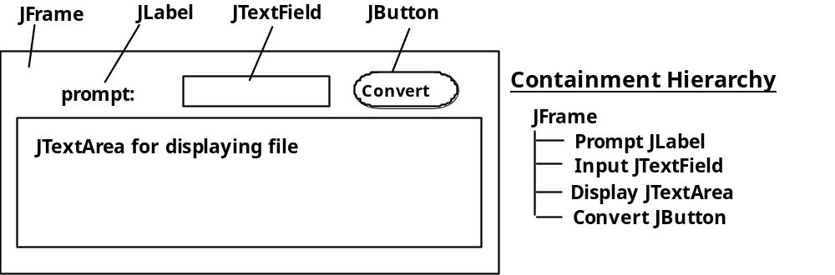
GUI Design: Layout
*
**
Notes:
In a FlowLayout components are arranged left to right in rows within the
container.
* The top-level window is a JFrame.
** The containment hierarchy shows which components are contained in
containers.

Slide 227
Implementing the Converter Class
import javax.swing.*; // Packages used
import java.awt.*;
import java.awt.event.*;
public class Converter extends JFrame implements ActionListener{
private JLabel prompt = new JLabel("Distance in miles: ");
private JTextField input = new JTextField(6);
private JTextArea display = new JTextArea(10,20);
private JButton convert = new JButton("Convert!");
public Converter() {
getContentPane().setLayout(new FlowLayout());
getContentPane().add(prompt);
getContentPane().add(input);
getContentPane().add(convert);
getContentPane().add(display);
display.setLineWrap(true);
display.setEditable(false);
convert.addActionListener(this);
} // Converter()
public void actionPerformed( ActionEvent e ) {
double miles = Double.valueOf(input.getText()).doubleValue();
double km = MetricConverter.milesToKm(miles);
display.append(miles + " miles equals " + km + " kilometers\n");
} // actionPerformed()
} // Converter
Notes:
1. Declare the components.
2. For top-level Swing windows, components are added to the content pane.
3. Invoking MetricConverter when the JButton is clicked.
4. Converting String to double in the actionPerformed method.

Slide 228
Instantiating the Top-Level JFrame
public static void main(String args[]) {
Converter f = new Converter();
f.setSize(400, 300);
f.setVisible(true);
// Quit the application
f.addWindowListener(new WindowAdapter() {
public void windowClosing(WindowEvent e) {
System.exit(0);
}
});
} // main()
Notes:
Observe the following in the code:
1. It is necessary to set the size and visibility.
2. An anonymous inner class is used to create an adapter to listen for
window close events.

Slide 229
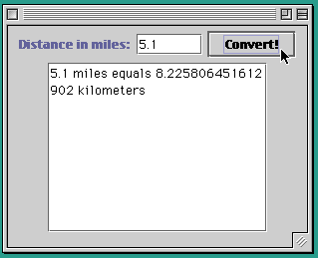
GUI Design Critique
Notes:
The above GUI is not user friendly for the following reasons:
The user has to manually clear the input field.
Effective Design: Minimize the user’s burden.
The user has to use both keyboard and mouse.
Effective Design: Minimize the number of input devices needed to
perform a single task.

Slide 230
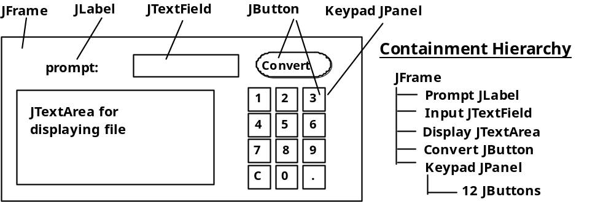
Extending the GUI: Button Array
Notes:
Make the JTextField a control so the user doesn’t have to use the mouse to
perform conversions.
Implement a 10-key pad so a conversion can be done with just the mouse control.
Effective Design: Redundant controls.
Note the use of a JPanel to hold buttons.

Slide 231
Implementing a Button Array
private JPanel keypadPanel; // Holds the buttons
private JButton keyPad[]; // An array of buttons
private String label[] = // And their labels
{ "1","2","3",
"4","5","6",
"7","8","9",
"C","0","." };
public void initKeyPad() {
keyPad = new JButton[NBUTTONS]; // Create the array itself
for(int k = 0; k < keyPad.length; k++) { // For each button
keyPad[k] = new JButton(label[k]); // Create a labeled button
keyPad[k].addActionListener(this); // and a listener
keypadPanel.add(keyPad[k]); // and add it to the panel
} // for
} // initKeyPad()
Notes:
Keypad JButtons and labels are stored in arrays:
From the constructor we will call initKeyPad() method which initializes
the keypad array with button labels, and keyPadPanel to the Jframe.

Slide 232
Implementing a Button Array (cont)
Keypad events are handled in actionPerformed():
public void actionPerformed(ActionEvent e) {
if (e.getSource() == convert || e.getSource() == input) {
double miles = Double.valueOf(input.getText()).doubleValue();
double km = MetricConverter.milesToKm(miles);
display.append(miles + " miles equals " + km + " kilometers\n");
input.setText("");
} else { // A keypad button was pressed
JButton b = (JButton)e.getSource();
if (b.getText().equals("C"))
input.setText("");
else
input.setText(input.getText() + b.getText());
}
} // actionPerformed()
Notes:
Clear the input using input.setText("");

Slide 233
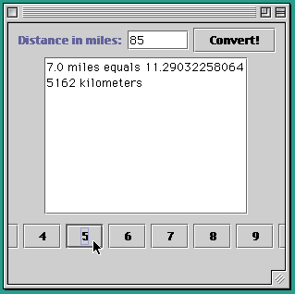
GUI Design Critique
Notes:
Problem: The default layout for a JPanel is FlowLayout. So the buttons
are placed next each others. We need GridLayout.

Slide 234
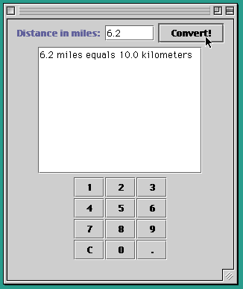
The GridLayout Manager
Notes:
Use the GridLayout of 4 rows and 3 columns with a space of one pixel
between rows and columns.
keypadPanel.setLayout(
new GridLayout(4,3,1,1));
Design Critique: We should use BorderLayout for top-level window.

Slide 235
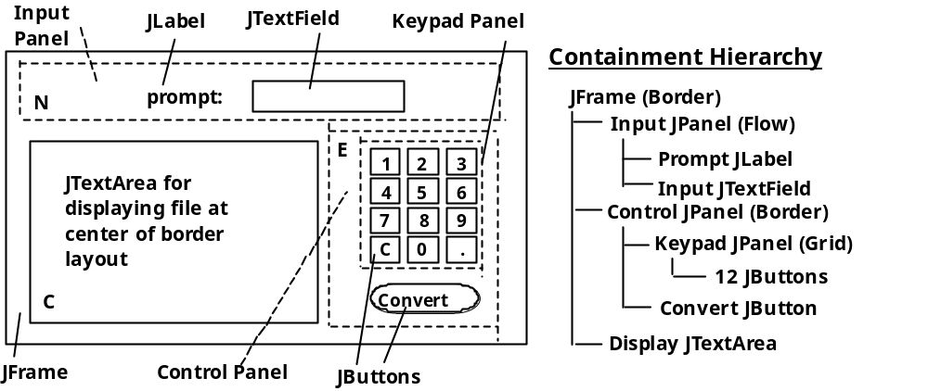
Converter: BorderLayout Design
Notes:
Panels are used to group components by function where ever possible. Each
panel is added to north, center and east.

Slide 236
Converter:
BorderLayout Implementation
public Converter() {
getContentPane().setLayout(new BorderLayout());
initKeyPad();
JPanel inputPanel = new JPanel(); // Input panel
inputPanel.add(prompt);
inputPanel.add(input);
getContentPane().add(inputPanel,"North");
JPanel controlPanel = new JPanel(new BorderLayout(0, 0)); // Controls
controlPanel.add(keypadPanel, "Center");
controlPanel.add(convert, "South");
getContentPane().add(controlPanel, "East");
getContentPane().add(display,"Center"); // Output display
display.setLineWrap(true);
display.setEditable(false);
convert.addActionListener(this);
input.addActionListener(this);
} // Converter()
Notes:
The GUI is laid out in the constructor of the Converter class.

Slide 237
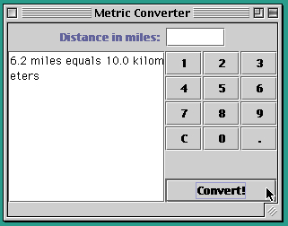
Converter: Final Version
Outputs
Notes:
In BorderLayout, when one or more areas is not used, then one or more of the
other areas fills its space, except for the center, which would be left blank if
unused.
In this case, the unused south area is filled by center and east.

Slide 238
Checkboxes
private JCheckBox titles[] = new JCheckBox[NTITLES];
private String titleLabels[] =
{"Chess Master - $59.95", "Checkers Pro - $39.95",
"Crossword Maker - $19.95"};
for(int k = 0; k < titles.length; k++) {
titles[k] = new JCheckBox(titleLabels[k]);
titles[k].addItemListener(this);
choicePanel.add(titles[k]);
}
Notes:
A JCheckBox is a button which always displays its current state (selected or not).
Used to select one or more options from a set.
In the above code snippet we are creating an array of checkboxes and an array
of checkbox labels. Each checkbox is given a listener and added to a JPanel.

Slide 239
Radio Buttons
private ButtonGroup optGroup = new ButtonGroup();
private JRadioButton options[] = new JRadioButton[NOPTIONS];
private String optionLabels[] = {"Credit Card", "Debit Card",
"E-cash"};
for(int k = 0; k < options.length; k++) {
options[k] = new JRadioButton(optionLabels[k]);
options[k].addItemListener(this);
optionPanel.add(options[k]);
optGroup.add(options[k] );
}
options[0].setSelected(true); // Set the first button on
Notes:
A JRadioButton is a button that belongs to a ButtonGroup of mutually
exclusive alternatives. Only one button from the group may be selected at a time.

Slide 240
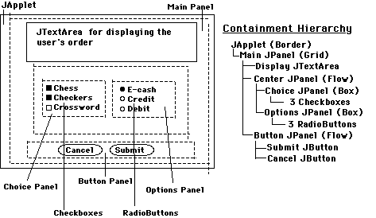
Design: The Online Order Form
Notes:
Problem: Design an applet-based order form that can be used for ordering
software over the Web, whose GUI looks like the picture in the slide.

Slide 241
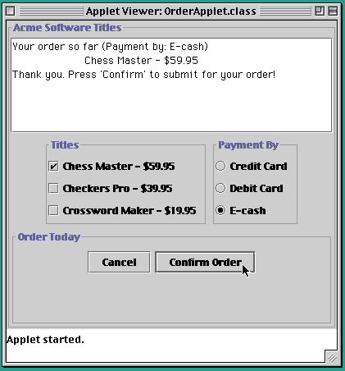
The Order Form Applet
Notes:
Create titled border for the panels.
choicePanel.setBorder(
BorderFactory.createTitledBorder("Titles"));

Slide 242
The ItemListener Interface
public void itemStateChanged(ItemEvent e) {
display.setText("Your order so far (Payment by: ");
for (int k = 0; k < options.length; k++ )
if (options[k].isSelected())
display.append(options[k].getText() + ")\n");
for (int k = 0; k < titles.length; k++ )
if (titles[k].isSelected())
display.append("\t" + titles[k].getText() + "\n");
} // itemStateChanged()
Notes:
ItemEvents are associated with items that make up menus, including
JCheckBoxes and RadioButtons.
They are handled by the ItemListener interface, which consists of the
itemStateChanged() method.
In the OrderApplet, each time the user selects a title or an option, the
itemStateChanged() method is executed.

Slide 243
The OrderApplet Class: Initialization
public class OrderApplet extends JApplet implements ItemListener, ActionListener {
private final int NTITLES = 3, NOPTIONS = 3;
private JPanel mainPanel = new JPanel(),
centerPanel = new JPanel(),
choicePanel = new JPanel(),
optionPanel = new JPanel(),
buttonPanel = new JPanel();
public void init() {
mainPanel.setBorder(BorderFactory.createTitledBorder("Acme Software Titles"));
mainPanel.setLayout(new GridLayout(3, 1, 1, 1));
cancel.addActionListener(this);
submit.addActionListener(this);
initChoices();
initOptions();
buttonPanel.setBorder( BorderFactory.createTitledBorder("Order Today"));
buttonPanel.add(cancel);
buttonPanel.add(submit);
centerPanel.add(choicePanel);
centerPanel.add(optionPanel);
mainPanel.add( display);
mainPanel.add(centerPanel);
mainPanel.add( buttonPanel);
getContentPane().add(mainPanel);
setSize(400,400);
} // init()
} // OrderApplet
import javax.swing.*;
import javax.swing.border.*;
import java.awt.*;
import java.awt.event.*;
Notes:
The OrderApplet’s init() method sets the layouts and adds components to panels.

Slide 244
OrderApplet Class: Handling Actions
public void actionPerformed(ActionEvent e){
String label = submit.getText();
if (e.getSource() == submit) {
if (label.equals("Submit Order")) {
display.append("Thank you. Press 'Confirm' to submit for your order!\n");
submit.setText("Confirm Order");
} else {
display.append("Thank you. You will receive your order tomorrow!\n");
submit.setText("Submit Order");
}
} else
display.setText("Thank you. Maybe we can serve you next time!\n");
} // actionPerformed()
Notes:
We make use of submit button for dual purpose by changing its label.

Slide 245
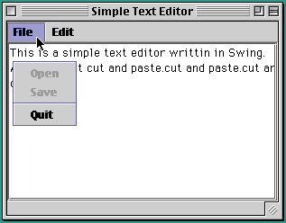
Menus
Notes:
Menus allow a program to grow without cluttering the interface.
A JMenuBar is a horizontal list of menus.
A JMenu is a clickable area on the menu bar that is associated with a
JPopupMenu, a small window that diplays JMenuItems.
JSeparators are used to group menu items.

Slide 246
Menu Example
Menus are hierarchical.
private void initFileMenu() {
fileMenu = new JMenu("File"); // Create the file menu
mBar.add(fileMenu); // and add it to the menu
openItem = new JMenuItem("Open"); // Open item
openItem.addActionListener( this );
openItem.setEnabled(false);
fileMenu.add(openItem);
saveItem = new JMenuItem("Save"); // Save item
saveItem.addActionListener(this);
saveItem.setEnabled(false);
fileMenu.add(saveItem);
fileMenu.addSeparator(); // Separator
quitItem = new JMenuItem("Quit"); // Quit item
quitItem.addActionListener(this);
fileMenu.add(quitItem);
} // initFileMenu()
Notes:
In the above example, menus are added to the menu bar. Menu items are added
to the menu. And action listeners are associated with menu items.

Slide 247
Handling Menu Actions
public void actionPerformed(ActionEvent e) {
JMenuItem m = (JMenuItem)e.getSource();
if ( m == quitItem ) { // Quit
dispose();
} else if (m == copyItem) // Copy
scratchPad = display.getSelectedText();
} else if (m == pasteItem) { // Paste
display.insert(scratchPad, display.getCaretPosition());
} else if ( m == selectItem ) {
display.selectAll(); // Select entire document
}
} // actionPerformed()
Notes:
Menu item selections generate ActionEvents.
Algorithm: Multiway selection. Test for each menu item and take appropriate
action.
Note:
Need to cast source object.
A scratchpad (String) is used to store text.

Slide 248
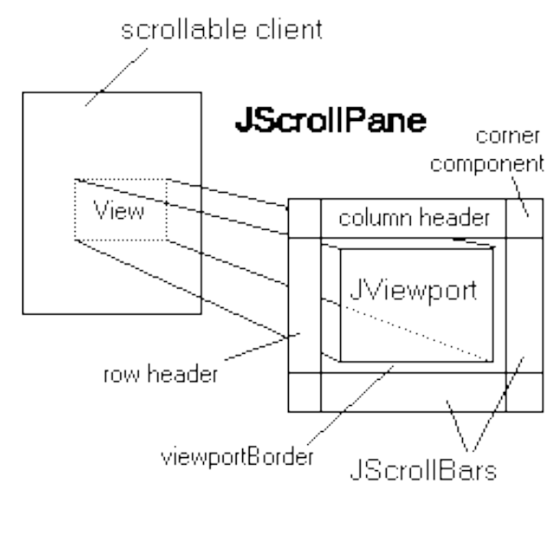
Scroll Panes
Parts of the ScrollPane:
Notes:
A JScrollPane is an object that manages scrolling within a window
or JTextArea.
this.getContentPane().add(new JScrollPane(display));
display refers to the scrollable component.

Slide 249
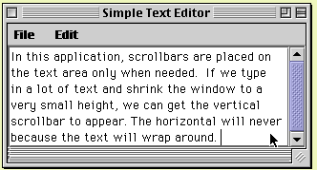
Scroll Pane: Example
Notes:
Scroll bars appear on the text area only when they are needed.
In the above example, since horizontal scroll bar is unnecessary we will get only
vertical scrollbar.

Slide 250
Try yourself: The ATM Machine
The objectives of this lab are:
To develop an ATM (Automatic Teller Machine) interface.
To develop a flexible interface design that will work with an applet or an application.
To gain additional practice using arrays.
To gain additional practice using AWT components and layouts.

Slide 251
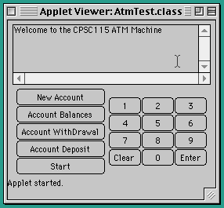
ATM Machine: Problem Statement
Notes:
Problem: Design and implement a Java class that simulates an ATM interface.
Hint: Don’t worry about implementing complete ATM functionality.

Slide 252
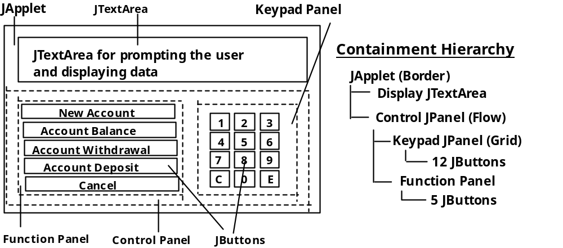
ATM Machine: GUI Specifications
Notes:
The GUI should contain a numeric keypad -- a 4 x 3 array of buttons -- and a
command pad, a set of buttons for ATM functions.

Slide 253
Design: AtmMachine Class
public AtmMachine(JFrame f) { // Application constructor from a frame
atmPanel = createInterface();
f.getContentPane().add(atmPanel);
f.pack();
f.show();
}
public AtmMachine(JApplet app) { // Applet constructor from an applet
atmPanel = createInterface();
app.getContentPane().add(atmPanel);
}
Notes:
The AtmMachine class should work with either an applet or application.
So we give it two constructors: one which receives JFrame and the other with
JApplet as the argument.

Slide 254
Design: Top-Level Class
import javax.swing.*;
import java.awt.*;
public class AtmApplication extends JFrame {
public static void main(String args[]) {
AtmApplication f = new AtmApplication();
f.setSize(300,500);
AtmMachine atm = new AtmMachine(f);
}
}
import javax.swing.*;
import java.awt.*;
import java.applet.Applet;
public class AtmTest extends JApplet {
AtmMachine atm;
public void init() {
setSize(500,300);
atm = new AtmMachine(this);
} // init()
} // AtmTest
Notes:
In the above two examples, top-level window is either JFrame or JApplet.
They pass their references to the AtmMachine constructor.

Slide 255
AtmMachine Class: Handling Actions
public void actionPerformed(ActionEvent e) {
Button b = (Button)e.getsource(); // Get action button
String label = b.getText(); // and its label
if (b == newAcc)
newAccount(); // New account
else if (b == accBal)
accountBalance(); // Check balance
else if (b == accDP)
accountDeposit(); // Make deposit
else if (b == accWD)
accountWithdrawal(); // Withdrawal
else if (b == cancel)
cancel(); // Cancel transaction
else
processKeyPad(label); // Process the 12 key pad
} // actionPerformed()

Slide 256
AtmMachine Class: Algorithm Design
private void cancel() {
if (state == INIT_STATE) {
cancel.setText("Cancel");
display.appendText("Please enter your PIN and click on ENTER.\n");
state = PIN_STATE;
} else if (state == GO_STATE || state == PIN_STATE)
state = INIT_STATE;
cancel.setText("Start");
} // cancel()
Notes:
Use a variable to remember the machine’s state. User actions lead to state
changes.
private static final int INIT_STATE = 0; // States
private static final int PIN_STATE = 1;
private static final int GO_STATE = 2;
private int state = 0; // Initial State
When cancel button is pressed, change to new state. The “Cancel” button toggles
between “Start” and “Cancel”.

Slide 257
Notes:
Summary Of Important Points
Graphical User Interface (GUI) components:
Abstract Windowing Toolkit (AWT): JDK 1.0 -1.2.
Swing: the GUI part of Java Foundation Classes (JFC) JDK 1.1,
1.2 (Java 2).
Written entirely in Java (pure Java).
Platform-independent look and feel.
Pluggable look-and-feel:
Windows 95 style
Unix-like Motif style
Java Metal style
Model-View-Controller (MVC): Components divided into three separate objects
look (view), state (model), and behavior (controller).
User interface classes -- combine look behavior, for a pluggable look-and-feel.
Peer model : every AWT component has a peer in the native windowing system.
This model is less efficient and more platform dependent than the MVC model.
Event model is based on event listeners -- objects responsibile for handling the
component’s events.
User interface design: guidance of the user, input, output and control.
Containment hierarchy: A hierarchy of the containers and their contents in a
GUI (JPanels and other Containers).
Content pane: Used by top-level Swing classes --- JApplet, JDialog, JFrame,
and JWindow --- as their component container.
A GUI should minimize the number of input devices that users need to
manipulate.
Redundancy: some forms -- e.g., two independent but complete sets of controls
--- are desirable.
Layout manager: manages the arrangement of the components in a container
(flow, border, grid and box layouts).
A radio button belongs to a group such that only one button may be selected at
a time. A checkbox is a toggle button that always displays its state.
Interface Design: reduce chance of user error and make it easy to recover from
errors when they do occur.

Slide 258
Summary
In this session, you learnt to:
Distinguish between AWT and Swing
Describe the need for Swing
Describe the MVC Architecture
Describe the event handling mechanism
State the layout managers
Use the layout managers
Develop some GUI based java applications

Slide 259
CHAPTER 10
Introduction to Applets

Slide 260
Objective
At the end of this session, you will be able to:
Define an applet
Describe an applet’s life cycle
State applets limitations
Describe the applet tag
Pass some information to applets via HTML
Write a program to establish inter-applet communication

Slide 261
Applets
Piece of Java code that runs in a browser environment.
Differs from an application in the way that it is executed.
Synopsis :
  public class Applet extends Panel
Notes:
Every applet is implemented by creating a subclass of the Applet class. The following figure in the next slide shows the inheritance hierarchy of the Applet class. This hierarchy determines much of what an applet can do and how, as you'll see on the next few slides.

Slide 262
Applet Class Hierarchy
java.lang.Object
java.awt.Component
java.awt.Container
java.awt.Panel
java.applet.Applet
Notes:
java.lang.Object
java.awt.Component
java.awt.Container
java.awt.Panel
java.applet.Applet
Applet Class Hierarchy

Slide 263
A Simple Applet
import java.awt.*;
import java.applet.Applet;
public class HelloWorld extends Applet {
public void paint(Graphics g) {
g.drawString(“Hello World”, 30, 30);
}
}
<HTML>
<APPLET CODE=“HelloWorld.class” WIDTH=200 HEIGHT=300>
</APPLET>
</HTML>
Notes:
The extends keyword indicates that HelloWorld is a subclass of the class whose name follows: Applet.
From the Applet class, applets inherit a great deal of functionality. Perhaps most important is the ability to respond to browser requests. For example, when a Java-capable browser loads a page containing an applet, the browser sends a request to the applet, telling the applet to initialize itself and start executing.
An applet isn't restricted to defining just one class. Besides the necessary Applet subclass, an applet can define additional custom classes. When the applet attempts to use a class, the application that's executing the applet first looks on the local host for the class. If the class isn't available locally, it's loaded from the location that the Applet subclass originated from.
The above <APPLET> tag specifies that the browser should load the class whose compiled code is in the file named HelloWorld.class. The browser looks for this file in the same directory as the HTML document that contains the tag. When the browser finds the class file, it loads it over the network, if necessary, onto the computer the browser is running on. The browser then creates an instance of the class. If you include an applet twice in one page, the browser loads the class file once and creates two instances of the class.
The WIDTH and HEIGHT attributes specify the size in pixels of the applet's display area.

Slide 264
Applet Life Cycle
init()
  called at the time applet is first created and loaded into a browser.
start()
  called to tell the applet it should become active.
  This happens when the applet first starts after the init() method, and
  whenever the browser is restored after being iconized, or
  when the browser returns to the page containing the applet after moving to another URL.
Notes:
Not every applet needs to override every one of these methods. Some very simple applets override none of them. For example, the HelloWorld doesn't override any of these methods, since it doesn't do anything except draw itself. The HelloWorld applet just displays a string once, using its paint method.Most applets, however, do more.
The init method is useful for one-time initialization that doesn't take very long. In general, the init method should contain the code that you would normally put into a constructor. The reason applets shouldn't usually have constructors is that an applet isn't guaranteed to have a full environment until its init method is called.
Every applet that does something after initialization (except in direct response to user actions) must override the start method. The start method either performs the applet's work or (more likely) starts up one or more threads to perform the work. You'll learn more about threads later in the next module.

Slide 265
Applet Life Cycle
stop()
  called when the applet ceases to be live.
  This happens when the browser is iconized, or
  follows a link to another URL.
destroy()
  called to inform the applet that it is being reclaimed.
Notes:
Most applets that override start should also override the stop method. The stop method should suspend the applet's execution, so that it doesn't take up system resources when the user isn't viewing the applet's page. For example, an applet that displays animation should stop trying to draw the animation when the user isn't looking at it.
destroy method is called by the browser or applet viewer to inform this applet that it is being reclaimed and that it should destroy any resources that it has allocated.
Many applets don't need to override the destroy method, since their stop method (which is called before destroy) does everything necessary to shut down the applet's execution. However, destroy is available for applets that need to release additional resources.

Slide 266
AWT Painting
paint(Graphics g)
  Exposure handling occurs automatically and results in a call to the paint() method.
  A facility of the graphics class called a clip rectangle is used to optimize the paint method so that the updates are restricted to the region that was being damaged.
repaint()
  used to notify the system that you want to change the display.
Notes:
The paint method is one of two display methods an applet can override:
paint
The basic display method. Many applets implement the paint method to draw the applet's representation within a browser page.
update
A method you can use along with paint to improve drawing performance.
Applets inherit their paint and update methods from the Applet class, which inherits them from the Abstract Window Toolkit (AWT) Component class.
Returning to the HelloWorld code snippet, the Graphics object passed into the paint method represents the applet's onscreen drawing context. The first argument to the Graphics drawString method is the string to draw onscreen. The second and third arguments are the (x,y) position of the lower left corner of the text onscreen. This applet draws the string "Hello World!" starting at location (50,25). The applet's coordinate system starts at (0,0), which is at the upper left corner of the applet's display area.

Slide 267
AWT Painting
update(Graphics g)
  Called as a result of repaint() method.
  Usually behaves by clearing the current display and then calling paint().
Notes:
repaint method causes a call to this component's update method as soon as possible.
The update method of Component does the following:
Clears this component by filling it with the background color.
Sets the color of the graphics context to be the foreground color of this component.
Calls this component's paint method to completely redraw this component.

Slide 268
AWT Painting
AWT Thread (waiting)
repaint()
Exposure
update() - clear area, call paint()
paint()

Slide 269
Applet Security Restriction
Applets are prevented from doing the following :
  Runtime execution of any other program.
  Any file I/O.
  Calls to any native method.
  Attempts to open a socket to any other process except the host that provided the applet.
The depth to which security is controlled is implemented at the browser level.
Notes:
Every browser implements security policies to keep applets from compromising system security.
However, the implementation of the security policies differs from browser to browser. Also, security policies are subject to change. For example, if a browser is developed for use only in trusted environments, then its security policies will likely be much more lax than those described above.
Each browser has a SecurityManager object that implements its security policies. When a SecurityManager detects a violation, it throws a SecurityException. Your applet can catch this SecurityException and react appropriately.

Slide 270
The APPLET Tag
<APPLET
[ARCHIVE = archiveList]
CODE = appletFileClass
WIDHT = pixels HEIGHT = pixels
[CODEBASE = codeBaseURL]
[ALT = alternateText]
[NAME = appletInstanceName]
[ALIGN = alignment]
[VSPACE = pixels] [HSPACE = pixels]
>
[<PARAM NAME = appletAttribute1 VALUE = value>]
</APPLET>
Notes:
The APPLET Tag

Slide 271
The APPLET Tag
ARCHIVE = archive List
CODEBASE = code base URL
ALT = alternate text
NAME = applet instance name
Notes:
ARCHIVE = archiveList
Describes one or more archives containing classes and other resources that will be preloaded.
CODEBASE = codeBaseURL
Specifies the base URL of the applet - the directory that contains the applet’s code, if not specified then document’s URL is used.
ALT = alternateText
Specifies any alternate text that should be displayed if the browser understands the APPLET tag but can not run Java applets.
NAME = appletInstanceName
Specifies a name for the applet instance, which makes it possible for the applets on the same page to find and communicate with each other.

Slide 272
Passing Information to Applets
import java.awt.*;
import java.applet.Applet;
public class MyApplet extends Applet {
String fontStr;
Font font;
public void init( ) {
fontStr = getParameter("font");
font = new Font(fontStr,Font.BOLD,30);
}
public void paint(Graphics g) {
g.setFont(font);
g.drawString("Hello World",40,40);
}
}
Notes:
Applets use the Applet getParameter method to get user-specified values for applet parameters. The getParameter method is defined as follows:
public String getParameter(String name)
Your applet might need to convert the string that getParameter returns into another form, such as an integer. The java.lang package provides classes such as Integer that you can use to help with converting strings to primitive types.
Note that if the user doesn't specify a value for the “font”parameter, It's important that you supply default values wherever possible.
Besides using the getParameter method to get values of applet-specific parameters, you can also use getParameter to get the values of attributes of the applet's <APPLET> tag.

Slide 273
Passing Information To Applets
<HTML>
<APPLET CODE = "MyApplet.class" WIDTH = 200 HEIGHT = 200>
<PARAM NAME=font VALUE="Serif">
</APPLET>
</HTML>

Slide 274
Inter-Applet Communication
import java.awt.*;
import java.applet.*;
import java.awt.event.*;
public class Demo extends Applet implements ActionListener {
public void init() {
Button b = new Button("Click to pass parameter to another Applet");
b.addActionListener(this);
add(b);
}
public void actionPerformed(ActionEvent e) {
System.out.println("Inside Demo...");
Applet dummy = getAppletContext().getApplet("Dummy");
((Dummy)dummy).setString("Coming From Applet Demo...");
}
}
Notes:
Applets can find other applets and send messages to them, with the following security restrictions:
Many browsers require that the applets originate from the same server.
Many browsers further require that the applets originate from the same directory on the server (the same code base).
The Java API requires that the applets be running on the same page, in the same browser window.
Some browsers let applets invoke methods on other applets -- even applets on different pages in the same browser -- as long as all of the applets come from the same code base. This method of interapplet communication isn't supported by the Java API, so it's possible that it will not be supported by all browsers.

Slide 275
Inter-Applet Communication
import java.applet.*;
import java.awt.*;
public class Dummy extends Applet {
String temp=null;
Font f;
public void init() {
temp = getParameter("Font");
f = new Font(temp,Font.ITALIC,28);
}
public void paint(Graphics g) {
g.setFont(f);
g.drawString(temp,30,30);
}
public void setString(String s) {
temp = s;
repaint();
}
}
Notes:
An applet can find another applet either by looking it up by name (using the AppletContext getApplet method) or by finding all the applets on the page (using the AppletContext getApplets method). Both methods, if successful, give the caller one or more Applet objects. Once the caller finds an Applet object, the caller can invoke methods on the object.

Slide 276
Inter - Applet Communication
<HTML>
<APPLET CODE="Demo.class" WIDTH=200 HEIGHT=50 NAME="Demo">
</APPLET>
<APPLET CODE="Dummy.class" WIDTH=400 HEIGHT=100 NAME="Dummy">
<PARAM NAME=Font VALUE="Serif">
</APPLET>
</HTML>
Notes:
The getApplet method looks through all of the applets on the current page to see if one of them has the specified name. If so, getApplet returns the applet's Applet object.
By default, an applet has no name. For an applet to have a name, one must be specified in the HTML code that adds the applet to a page. You can specify an applet's name in two ways:
By specifying a NAME attribute within the applet's <APPLET> tag. For example:
<APPLET CODEBASE=example/ CODE=Sender.class
WIDTH=450
HEIGHT=200
NAME=”Demo">
. . .
</applet>
By specifying a NAME parameter with a <PARAM> tag. For example:
<APPLET CODEBASE=example/ CODE=Receiver.class
WIDTH=450
HEIGHT=35>
<PARAM NAME="name" value=”Dummy">
. . .
</applet>

Slide 277
The showStatus() Method
import java.awt.*;
import java.awt.event.*;
import java.applet.*;
public class Button2New extends Applet {
Button b1 = new Button("Button 1"),
b2 = new Button("Button 2");
public void init() {
b1.addActionListener(new B1());
b2.addActionListener(new B2());
add(b1);
add(b2);
}
class B1 implements ActionListener {
public void actionPerformed(ActionEvent e) {
getAppletContext().showStatus("Button 1");
}
}
class B2 implements ActionListener {
public void actionPerformed(ActionEvent e) {
getAppletContext().showStatus("Button 2"); }
}
}
Notes:
All applet viewers -- from the Applet Viewer to Java-compatible browsers -- allow applets to display a short status string.
The status line is not usually very prominent, and it can be overwritten by other applets or by the browser. For these reasons, it's best used for incidental, transitory information. For example, an applet that loads several image files might display the name of the image file it's currently loading.
Applets display status lines with the showStatus method. Here's an example of its use:
showStatus("MyApplet: Loading image file " + file);
Note: Don't put scrolling text in the status line. Browser users find such status line abuse highly annoying!

Slide 278
Summary
In this session, you learnt to:
Define an applet
Describe an applet’s life cycle
State applets limitations
Describe the applet tag
Pass some information to applets via HTML
Write a program to establish inter-applet communication

Slide 279
CHAPTER 11
Multithreading

Slide 280
Objective
In this session, you will be able to:
Define a thread
Create threads in java using two approaches
Describe the life cycle of a thread
Synchronize threads

Slide 281


Thread
A thread is a single sequential flow of control within a program.
lightweight process
execution context
Notes:
Thread is a logical sequence of execution of code lines.
The entire code can be divided in to different logical groups and each group can be called as a thread of execution.
The Java thread is a light weight process because it does not consume time and other resources for launching it.
A thread is similar to the sequential programs described previously. A single thread also has a beginning, a
sequence, and an end and at any given time during the runtime of the thread, there is a single point of
execution. However, a thread itself is not a program; it cannot run on its own. Rather, it runs within a
program. The following figure shows this relationship.
There is nothing new in the concept of a single thread. The real hoopla surrounding threads is not about a
single sequential thread. Rather, it's about the use of multiple threads in a single program, running at the same
time and performing different tasks. This is illustrated in the above figure.

Slide 282
Threads in Java
There are two techniques for creating a thread:
  Subclassing Thread and Overriding run
  Implementing the Runnable Interface
Notes:
Selecting a way to create threads:
Implementing Runnable interface
This gives the advantage of better object-oriented design. It uses only single inheritance.
The option of extending from Thread class will lead to simple code.
Because java technology allows only single inheritance, it is not possible to extend from any other class, if already we have extended from Thread. In some situations, this forces to take the approach of implementing Runnable.

Slide 283
The Runnable Interface
The Runnable interface should be implemented by any class whose instances are intended to be executed by a thread.
The class must define a method of no arguments called run.
public void run()
  When an object implementing interface Runnable is used to create a thread, starting the thread causes the object's run method to be called in that separately executing thread.
Notes:
The Runnable interface should be implemented by any class whose instances are intended to be executed by a thread. The class must define a method of no arguments called run.
This interface is designed to provide a common protocol for objects that wish to execute code while they are active. For example, Runnable is implemented by class Thread. Being active simply means that a thread has been started and has not yet been stopped.
In addition, Runnable provides the means for a class to be active while not subclassing Thread. A class that implements Runnable can run without subclassing Thread by instantiating a Thread instance and passing itself in as the target. In most cases, the Runnable interface should be used if you are only planning to override the run() method and no other Thread methods. This is important because classes should not be subclassed unless the programmer intends on modifying or enhancing the fundamental behavior of the class.

Slide 284
The Thread Class
Thread()
- Allocates a new Thread object.
Thread(Runnable target)
- Allocates a new Thread object.
Thread(Runnable target,String name)
- Allocates a new Thread object.
Thread(String name)
- Allocates a new Thread object.
Notes:
A thread is a thread of execution in a program. The Java Virtual Machine allows an application to have multiple threads of execution running concurrently.
When a Java Virtual Machine starts up, there is usually a single non-daemon thread (which typically calls the method named main of some designated class). The Java Virtual Machine continues to execute threads until either of the following occurs:
The exit method of class Runtime has been called and the security manager has permitted the exit operation to take place.
All threads that are not daemon threads have died, either by returning from the call to the run method or by throwing an exception that propagates beyond the run method.

Slide 285
Notes:
Thread class
static Thread currentThread()
Returns a reference to the currently executing thread object.
String getName()
Returns this thread's name
int getpriority()
Returns this thread's priority.
ThreadGroup getThreadGroup()
Returns the thread group to which this thread belongs.
void destroy()
Destroys this thread, without any cleanup.
void start()
Causes this thread to begin execution; the Java Virtual Machine calls the run method of this thread.
static void sleep(long millis)
Causes the currently executing thread to sleep (temporarily cease execution) for the specified number of milliseconds.
void run()
If this thread was constructed using a separate Runnable run object, then that Runnable object's run method is called; otherwise, this method does nothing and returns.
void start()
Causes this thread to begin execution; the Java Virtual Machine calls the run method of this thread.

Slide 286
Subclassing Thread
class SimpleThread extends Thread {
public SimpleThread(String str) {
super(str);
}
public void run() {
for (int i = 0; i < 10; i++) {
System.out.println(i + " " + getName());
try {
sleep((long)(Math.random() * 1000));
} catch (InterruptedException e) {}
}
System.out.println("DONE! " + getName());
}
}
Notes:
The first way to customize what a thread does when it is running is to subclass Thread (itself a Runnable object) and override its empty run method so that it does something.
The first method in the SimpleThread class is a constructor that takes a String as its only argument. This constructor is implemented by calling a superclass constructor and is interesting to us only because it sets the Thread's name, which is used later in the program.
The next method in the SimpleThread class is the run method. The run method is the heart of any Thread and where the action of the Thread takes place. The run method of the SimpleThread class contains a for loop that iterates ten times. In each iteration the method displays the iteration number and the
name of the Thread, then sleeps for a random interval of up to 1 second. After the loop has finished, the run method prints DONE! along with the name of the thread. That's it for the SimpleThread class. Following program will test this class.
public class ThreadTest {
public static void main String[] args) {
SimpleThread st1 = new SimpleThread(“Thread A”);
SimpleThread st2 = new SimpleThread(“Thread B”)
st1.start();
st2.start();
// OR
new SimpleThread(“Thread A”).start();
new SimpleThread(“Thread B”).start(); } }

Slide 287
Implementing the Runnable Interface
class SimpleThread implements Runnable {
public void run() {
Thread t = Thread.currentThread();
for (int i = 0; i < 10; i++) {
System.out.println(i + " " + t.getName() );
try {
Thread.sleep((long)(Math.random() * 1000));
} catch (InterruptedException e) {}
}
System.out.println("DONE! " + t.getName());
}
}
Notes:
If your class must subclass some other class (the most common example
being Applet), you should use Runnable
Following class tests the above example.
public class RunTest {
public static void main (String[] args) {
Runnable r1 = new SimpleThread();
Runnable r2 = new SimpleThread();
Thread t1 = new Thread(r1,"Thread A");
Thread t2 = new Thread(r2,"Thread B");
t1.start();
t2.start();
}
}

Slide 288
Implementing the Runnable Interface
import java.util.*;
import java.text.DateFormat;
import java.applet.Applet;
public class Clock extends Applet implements Runnable {
private Thread clockThread = null;
public void start() {
if (clockThread == null) {
clockThread = new Thread(this, "Clock");
clockThread.start();
}
}//start
public void run() {
Thread myThread = Thread.currentThread();
while (clockThread == myThread) {
repaint();
try {
Thread.sleep(1000);
} catch (InterruptedException e){}
}//while
}//run
Notes:
The Clock applet shown in the slide displays the current time and updates its display every second.
Instead of subclassing Thread, Clock implements the Runnable interface (and therefore implements the run method defined in it). Clock then creates a thread and provides itself as an argument to the Thread's constructor. When created in this way, the Thread gets its run method from the object passed into the constructor.
To run in a Java-enabled browser, the Clock class has to be a subclass of the Applet class. Also, the Clock applet needs a thread so that it can continuously update its display without taking over the process in which it is running. (Some browsers might create a new thread for each applet so as to prevent a
misbehaved applet from taking over the main browser thread. However, you should not count on this when writing your applets; your applets should create their own threads when doing computer-intensive work.)
But since the Java language does not support multiple class inheritance, the Clock class cannot be a subclass of both Thread and Applet. Thus the Clock class must use the Runnable interface to provide its threaded behavior.

Slide 289
Implementing the Runnable Interface
public void paint(Graphics g) {
// get the time and convert it to a date
Calendar cal = Calendar.getInstance();
Date date = cal.getTime();
// format it and display it
DateFormat dateFormatter = DateFormat.getTimeInstance();
g.drawString(dateFormatter.format(date), 50, 50);
}//paint
// overrides Applet's stop method
public void stop() {
clockThread = null;
}//stop
}// Clock
Notes:
The Clock applet's run method loops until the browser asks it to stop. During each iteration of the loop, the clock repaints its display. The paint method figures out what time it is, formats it in a localized way, and displays it. You'll see more of the Clock applet in The Life Cycle of a Thread which uses it to teach you about the life of a thread.

Slide 290

The Life Cycle of a Thread
Creating a Thread
Starting a Thread
Making a Thread Not Runnable
Stopping a Thread
Notes:
This diagram shows the states that a Java thread can be in during its life. It also illustrates which method calls cause a transition to another state. This figure is not a complete finite state diagram, but rather an overview of the more interesting and common facets of a thread's life. The remainder of this section uses the Clock applet previously introduced to discuss a thread's life cycle in terms of its state.

Slide 291
The Life Cycle of a Thread
Creating a Thread:
public void start() {
if (clockThread == null) {
clockThread = new Thread(this, "Clock");
clockThread.start();
}
}
After the statement containing new is executed, clockThread is in the New Thread state; no system resources are allocated for it yet.
When a thread is in this state, we can only call the start method on it.
Notes:
After the bold statement has been executed, clockThread is in the New Thread state. When a thread is a New Thread, it is merely an empty Thread object; no system resources have been allocated for it yet.When a thread is in this state, you can only start the thread. Calling any method besides start when a thread
is in this state makes no sense and causes an IllegalThreadStateException. (In fact, the runtime system throws an IllegalThreadStateException any time a method is called on a thread and that thread's state does not allow for that method call.)
Notice that this--the Clock instance-- is the first argument to the thread constructor. The first argument to this thread constructor must implement the Runnable interface and provides the thread with its run method.
The second argument is just a name for the thread.

Slide 292
The Life Cycle of a Thread
Starting a Thread :
public void start() {
if (clockThread == null) {
clockThread = new Thread(this, "Clock");
clockThread.start();}}
The start method creates the system resources necessary to run the thread, schedules the thread to run, and calls the thread's run method.
After the start method returns, the thread is said to be "running". In reality a thread that has been started is actually in the Runnable state.
At any given time, a "running" thread actually may be waiting for its turn in the CPU.
Notes:
The start method creates the system resources necessary to run the thread, schedules the thread to run, and calls the thread's run method. clockThread's run method is the one defined in the Clock class.
After the start method has returned, the thread is "running". Yet, it's somewhat more complex than that. As the previous figure shows, a thread that has been started is actually in the Runnable state. Many computers have a single processor, thus making it impossible to run all "running" threads at the same time. The Java runtime system must implement a scheduling scheme that shares the processor between all "running" threads.

Slide 293
The Life Cycle of a Thread
The run( ) method :
public void run() {
Thread myThread = Thread.currentThread();
while (clockThread == myThread) {
repaint();
try {
Thread.sleep(1000);
} catch (InterruptedException e){}
}}
Clock's run method loops while the condition
clockThread = = myThread is true.
Within the loop, the applet repaints (which further calls paint) itself and then tells the thread to sleep for one second.
Notes:
Clock's run method loops while the condition clockThread == myThread is true. Within the loop, the applet repaints itself and then tells the thread to sleep for one second (1000 milliseconds). An applet's repaint method ultimately calls the applet's paint method, which does the actual update of the applet's display area. The Clock paint method gets the current time, formats, and displays it:
public void paint(Graphics g) {
// get the time and convert it to a date
Calendar cal = Calendar.getInstance();
Date date = cal.getTime();
// format it and display it
DateFormat dateFormatter = DateFormat.getTimeInstance();
g.drawString(dateFormatter.format(date), 5, 10);
}

Slide 294
The Life Cycle of a Thread
Making a Thread Not Runnable:
A thread becomes Not Runnable when one of these events occurs:
  Its sleep( ) method is invoked.
  The thread calls the wait( ) method to wait for a specific condition to be satisifed.
  The thread is blocking on I/O.

Slide 295
The Life Cycle of a Thread
The clockThread in the Clock applet becomes Not Runnable when the run method calls sleep on the current thread:
public void run() {
Thread myThread = Thread.currentThread();
while (clockThread == myThread) {
repaint();
try {
Thread.sleep(1000);
} catch (InterruptedException e){}
}
}
Notes:
During the second that the clockThread is asleep, the thread does not run, even if the processor becomes available. After the second has elapsed, the thread becomes Runnable again and, if the processor becomes available, the thread begins running again.
For each entrance into the Not Runnable state, there is a specific and distinct escape route that returns the thread to the Runnable state. An escape route works only for its corresponding entrance. For example, if a thread has been put to sleep, then the specified number of milliseconds must elapse before the thread becomes Runnable again.
If a thread is waiting for a condition, then another object must notify the waiting thread of a change in condition by calling notify or notifyAll.
If a thread is blocked on I/O, then the I/O must complete.

Slide 296
The Life Cycle of a Thread
Stopping a Thread :
A program doesn't stop a thread, rather, a thread arranges for its own death by having a run method that terminates naturally. For example, the while loop in this run method is a finite loop-- it will iterate 100 times and then exit:
public void run() {
int i = 0;
while (i < 100) {
i++;
System.out.println("i = " + i);
} }
A thread with this run method dies naturally when the loop completes and the run method exits.
Notes:
A program doesn't stop a thread like it stops an applet (by calling a method). Rather, a thread arranges for its own death by having a run method that terminates naturally. For example, the while loop in this run method is a finite loop-- it will iterate 100 times and then exit:
A thread with this run method dies naturally when the loop completes and the run method exits.

Slide 297
The Life Cycle of a Thread
Stopping a Thread :
  Stopping the Clock applet thread
public void run() {
Thread myThread = Thread.currentThread();
while (clockThread == myThread) {
repaint();
try {
Thread.sleep(1000);
} catch (InterruptedException e){}
}}
The exit condition for this run method is the exit condition for the while loop because there is no code after the while loop:
while (clockThread = = myThread)
Notes:
Let's look at how the Clock applet thread arranges for its own death. You might want to use this technique with your applets. Recall Clock's run method:
The exit condition for this run method is the exit condition for the while loop because there is no code after the while loop:
while (clockThread == myThread) {
This condition indicates that the loop will exit when the currently executing thread is not equal to clockThread.

Slide 298
The Life Cycle of a Thread
Stopping a Thread :
  Stopping the Clock applet thread
When we leave the page, the application in which the applet is running calls the applet's stop method. This method then sets the clockThread to null, thereby telling the main loop in the run method to terminate:
public void stop() {// applets' stop method
clockThread = null; }
If we revisit the page, the start method is called again and the clock starts up again with a new thread.
Notes:
When you leave the page, the application in which the applet is running calls the applet's stop method. This method then sets the clockThread to null, thereby telling the main loop in the run method to terminate:
If you revisit the page, the start method is called again and the clock starts up again with a new thread.
Even if you stop and start the applet faster than one iteration of the loop, clockThread will be a different thread than myThread and the loop will still terminate.

Slide 299
The Life Cycle of a Thread
The isAlive() Method :
  The isAlive() method returns true if the thread has been started and not stopped.
  If the isAlive() method returns false, you know that the thread either is a New Thread or is dead.
  If the isAlive() method returns true, you know that the thread is either Runnable or Not Runnable.
Notes:
The API for the Thread class includes a method called isAlive. The isAlive method returns true if the thread has been started and not stopped. If the isAlive method returns false, you know that the thread either is a New Thread or is Dead. If the isAlive method returns true, you know that the thread is either Runnable or Not Runnable. You cannot differentiate between a New Thread or a Dead thread. Nor can you differentiate between a Runnable thread and a Not Runnable thread.

Slide 300
Thread Priority
The Java runtime supports fixed priority preemptive scheduling.
When a Java thread is created, it inherits its priority from the thread that created it. Which can be changed later using the setPriority method.
Thread priorities are integers ranging between MIN_PRIORITY and MAX_PRIORITY.
Notes:
threads run concurrently.
While conceptually this is true, in practice it usually isn't. Most computer configurations have a single CPU, so threads actually run one at a time in such a way as to provide an illusion of concurrency. Execution of multiple threads on a single CPU, in some order, is called scheduling. The Java runtime supports a very simple, deterministic scheduling algorithm known as fixed priority scheduling. This algorithm schedules threads based on their priority relative to other runnable threads.
When a Java thread is created, it inherits its priority from the thread that created it. You can also modify a thread's priority at any time after its creation using the setPriority method. Thread priorities are integers ranging between MIN_PRIORITY and MAX_PRIORITY (constants defined in the Thread class). The higher the integer, the higher the priority. At any given time, when multiple threads are ready to be executed, the runtime system chooses the runnable thread with the highest priority for execution. Only when that thread
stops, yields, or becomes not runnable for some reason will a lower priority thread start executing. If two threads of the same priority are waiting for the CPU, the scheduler chooses one of them to run in a round-robin fashion.

Slide 301
Thread Priority
The runtime system chooses the runnable thread with the highest priority for execution.
If two threads of the same priority are waiting for the CPU, the scheduler chooses one of them to run in a round-robin fashion.
The chosen thread will run until one of the following conditions is true:
  A higher priority thread becomes runnable.
  It yields, or its run method exits.
  On systems that support time-slicing, its time allotment has expired.
Notes:
The chosen thread will run until one of the following conditions is true:
A higher priority thread becomes runnable.
It yields, or its run method exits.
On systems that support time-slicing, its time allotment has expired.
Then the second thread is given a chance to run, and so on, until the interpreter exits.
The Java runtime system's thread scheduling algorithm is also preemptive. If at any time a thread with a higher priority than all other runnable threads becomes runnable, the runtime system chooses the new higher priority thread for execution. The new higher priority thread is said to preempt the other threads.

Slide 302
Controlling Threads
It’s an art of moving threads from one state to another state.
It is achieved by triggering state transitions.
The various pathways out of the running state can be :
  Yielding
  Suspending and then resuming
  Sleeping and then waking up
  Blocking and then continuing
  Waiting and then being notified

Slide 303
Yielding
A call to yield method causes the currently executing thread to move to the ready state, if the scheduler is willing to run any other thread in place of the yielding thread.
A thread that has yielded goes into ready state.
The yield method is a static method of the Thread class.
ready
scheduled
yield()
running

Slide 304
Suspending
It’s a mechanism that allows any arbitrary thread to make another thread un-runnable for an infinite period of time.
The suspended thread becomes runnable when some other thread resumes it
Deadlock prone, because the control comes from outside the thread.
The exact effect of suspend and resume is much better implemented using wait and notify.
Notes:
It may sometimes be useful to temporarily stop a thread from processing in your application. When you suspend a thread, the state of the thread, including all the attributes and locks held by the thread, is maintained until that thread is resumed.
Use thread suspension carefully. Suspending threads can easily cause application deadlocks and timeout conditions. You can solve most problems that involve thread suspension by using other safer mechanisms (such as synchronization).
Thread.suspend is inherently deadlock-prone so it is also being deprecated, thereby necessitating the deprecation of Thread.resume. If the target thread holds a lock on the monitor protecting a critical system resource when it is suspended, no thread can access this resource until the target thread is resumed. If the thread that would resume the target thread attempts to lock this monitor prior to calling resume, deadlock results. Such deadlocks typically manifest themselves as "frozen" processes.

Slide 305
Sleeping
A sleeping thread passes time without doing anything and without using the CPU.
A call to the sleep method requests the currently executing thread to cease it’s execution for a specified period of time.
  public static void sleep(long ms)
  throws InterruptedException
  public static void sleep(long ms, int ns)
  throws InterruptedException
Both sleep and yield work on currently executing thread.

Slide 306
Blocking
Methods that perform input or output have to wait for some occurrence in the outside world before they can proceed, this behavior is known as blocking.
try {
Socket s = new Socket(“Devil”,5555);
InputStream is = s.getInputStream();
int b = is.read();
}
catch(IOException e) {
// Handle the exception}

Slide 307
Blocking
A thread can also become blocked if it fails to acquire the lock for a monitor if it issues a wait( ) call.
The wait( ) method puts an executing thread into the waiting state, and the notify( ) and notifyAll( ) put them back to ready state.

Slide 308
Thread Synchronization
public class Consumer extends Thread {
private MailBox mailBoxObj;
public Consumer(Mailbox box) {
this.mailBoxObj = box;
}
public void run() {
while(true) {
if(mailBoxObj.request) {
System.out.println(mailBoxObj.msg);
mailBoxObj.request = false;
}
try {
sleep(50);
} catch(InterruptedException e){}
}
}
Notes:
Pitfalls
On a time sliced system, the Consumer thread could just possibly be interrupted between the statements, if(mailBoxObj.request) and System.out.println(mailBoxObj.str);
The interrupting thread could just possibly be a client, that sets msg to it’s own message (without checking request). The Consumer thread will then send the wrong message.
The choice of 50 milliseconds for the delay can never be ideal.
Better Solution
The MailBox should be able to protect it’s data from irresponsible clients.
If the MailBox is not available (if the request flag is already set), then the client consumer should not have to guess how long to wait, before checking the flag again.

Slide 309
Better Solution
class MailBox{
private boolean request;
private String msg;
public synchronized void storeMessage( String s){
request = true;
msg = s;
}
public synchronized String retrieveMessage(){
request = false;
return msg;
}
}
Notes:
Better Solution
Class Mailbox{
private boolean request;
private String msg;
public synchronized void storeMessage( String s){
request = true;
msg = s;
}
public synchronized String retrieveMessage(){
request = false;
return msg;
}
}

Slide 310
The Complete Solution
public synchronized String retrieveMessage(){
  while(request == false){ // No message to retrieve
  try{
wait();
  } catch((InterruptedException e) {}
}
request = false;
notify();
return str;
}
Notes:
The Complete Solution :
class MailBox {
private boolean request;
private String msg;
public synchronized void storeMessage( String s){
while(request == true){ // no room for another message
try{
wait();
} catch(InterruptedException e) {}
}
request = true;
msg = s;
notify();
}
public synchronized String retrieveMessage(){
while(request == false){ // No message to retrieve
try{
wait();
} catch(InterruptedException e) {}
}
request = false;
notify();
return msg;
}
}

Slide 311
Summary
In this session, you learnt to:
Define a thread
Create threads using two approaches
Describe the life cycle of a thread
Synchronize threads

Slide 312
THANK YOU

